Slide 1
In Memoriam
Emmanuel Farhi

Slide 2
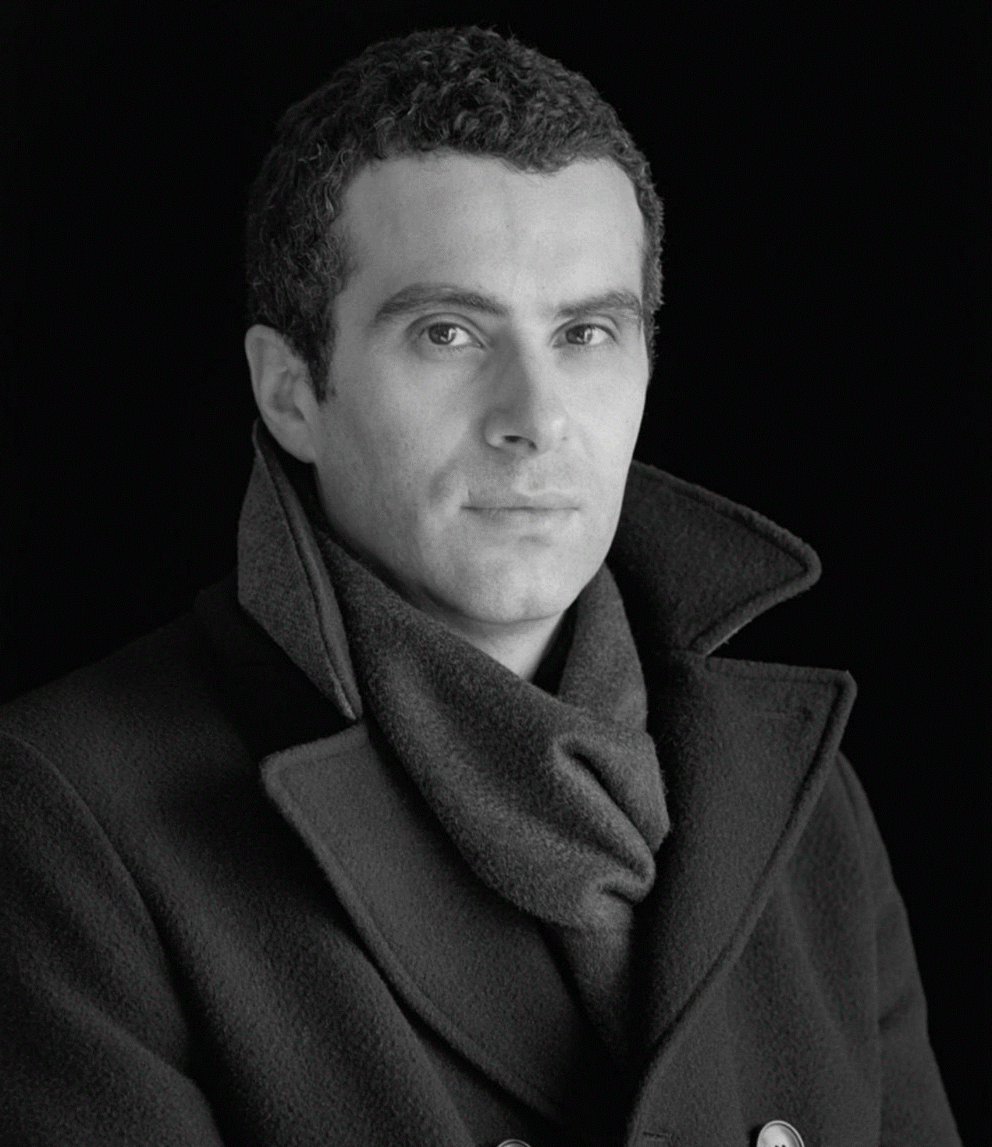
In Memoriam
Emmanuel Farhi

Slide 3
In Memoriam
Emmanuel Farhi

Slide 4
In Memoriam
Emmanuel Farhi

Slide 5
In Memoriam
Emmanuel Farhi

Slide 6
In Memoriam
Emmanuel Farhi

Slide 7
In Memoriam
Emmanuel Farhi

