Slide 1
Understanding the Dynamics of China-US Trade Asymmetries
Kejian GU
The Harvard Economics Department, Boston,
March 27, 2019

Slide 2
Understanding the Dynamics of China-US Trade Aymmetries
Problem settings
A conceptual framework on bilateral trade asymmetries
Decomposition
Decoupling US economy and China? Potential Aftermath of the Asymmetries
scenarios from China
Policy implications
01

Slide 3
Problem settings
Missing term: Trade balance in the orthodoxy trade model
Orthodoxy model focus on pure term of intentional trade
The critical issue: trade balance as an hottest topic since Obama initiatives in G20 Summit since 2009( See, Kejian GU et al , he balanced global growth issue and trade friction in China memo , 2016 )

Slide 4
Trade balance: Missing term in the orthodoxy framework of international trade
Assuming constant TOT
Ricardian Model
Dornmush-Sameulson-Fisher Model
Learning From H-O-Vanek

Slide 5
Ricardian Model
Home Country
Yes
No
Foreign Country
Yes
X: 2.2
X: 1
Y: 2.125
Y: 3.125
X: 3.2
X：2
No
Y: 1
Y: 2

Slide 6
The case with two–product

Slide 7
The case with multi-product

Slide 8
H-0-Vanek Model
Embracement of factor consumption

Slide 9
Alessandria-Choi Formula
THE ongoing decomposition of Trade Balance.
See, Alessandria, G., et al, The dynamics of the U.S. Trade Balance and Real Exchange Rate: the J Curve and Trade Cost? NBER WORKING PAPER 25563
The my decomposition specific to TRY due to mathematic wisdom
Elasticity of TRY (TBTR, ALSO) to TBY=UNITARY

Slide 10
Decomposition specific to TRY due to mathematic wisdom: a Test from US DATA

Slide 11
A conceptual framework on bilateral trade
Define a comprehensive balance sheet for trade, which is different from current BOP
Trade term; National Account

Slide 12
Asymmetry in China-US trade with trade term
Changes in asymmetries of Factor endowment
National account relevance

Slide 13
Intuitively, Fed Fund Rate versus Shibor

Slide 14
Difference in minimum wage

Slide 15
US RCI

Slide 16
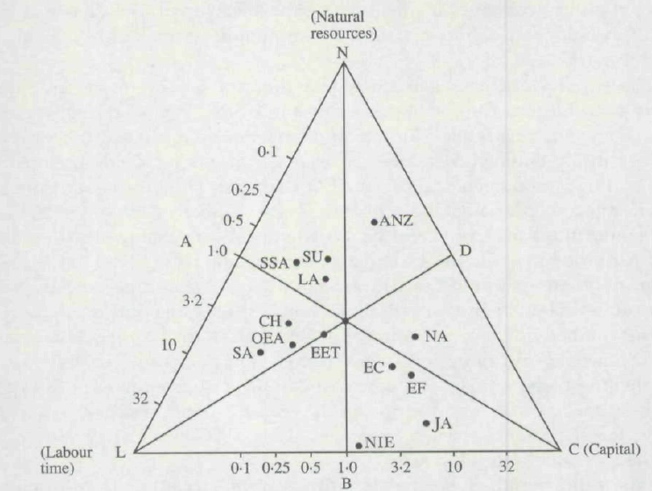
Leamer’s Triangle ： Anderson’ s Perspective in 1989

Slide 17
Leamer’s Triangle ： GU’ s Perspective in 2004

Slide 18
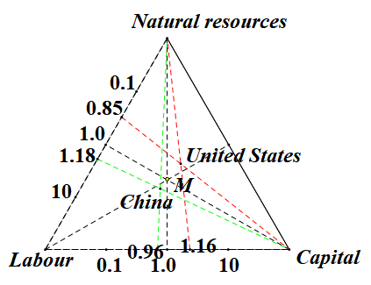
Leamer’s Triangle ： GU’ s Perspective in 2017

Slide 19
Decoupling US economy and China? Potential Aftermath of the Asymmetries
Asymmetric of the changes in China and US as trade powerhouses
China vs. US: Import_ consumption; Export vs. Savings

Slide 20
Asymmetric of the changes in China and US as trade powerhouses
Decreased role of China as an trade powerhouse
Meanwhile, increasing share of US Trade Dependent to GDP

Slide 21
The changes in China and US as trade powerhouses

Slide 22
Import_ consumption： China and US

Slide 23
Export vs. Savings ： China and US

Slide 24
Asymmetry in China-US trade with national within account term: Argument
Export & import
Consumption & Savings
Dummy variables

Slide 25
Asymmetry in China-US trade with national within account term
 | (1)
VARIABLES | lnconsump_usa
lnchn_usa | 0.0316*
 | (0.0175)
t_2009 | 1.283***
 | (0.330)
t_2009_lnchn_usa | -0.0741***
 | (0.0193)
lngdp_usa | 0.965***
 | (0.0744)
Constant | -0.145
 | (0.946)
Observations | 19
R-squared | 0.999
 | (1) | (2) | (3)
VARIABLES | consump_chn | consump_usa | consump_usa
usa_chn | 0.231***
 | (0.0195)
t_2009 | -1.369e+06 |  | 1.403e+06
 | (803,338) |  | (844,622)
t_2009_usa_chn | 0.213***
 | (0.0696)
chn_usa |  | 0.714*** | 0.214***
 |  | (0.0668) | (0.0146)
t_2001 |  | 3.370e+06***
 |  | (365,356)
t_2001_chn_usa |  | -0.542***
 |  | (0.0673)
t_2009_chn_usa |  |  | -0.0600*
 |  |  | (0.0289)
Constant | 198,554*** | 4.553e+06*** | 7.141e+06***
 | (62,979) | (334,515) | (277,195)
Observations | 20 | 19 | 19
R-squared | 0.950 | 0.985 | 0.975
Robust standard errors in parentheses
*** p<0.01, ** p<0.05, * p<0.1
Robust standard errors in parentheses
*** p<0.01, ** p<0.05, * p<0.1

Slide 26
Asymmetry in China-US trade with national within account term **
 | (1) | (2) | (3)
VARIABLES | consump_chn | consump_usa | consump_usa
usa_chn | 0.231***
 | (0.0195)
t_2009 | -1.369e+06 |  | 1.403e+06
 | (803,338) |  | (844,622)
t_2009_usa_chn | 0.213***
 | (0.0696)
chn_usa |  | 0.714*** | 0.214***
 |  | (0.0668) | (0.0146)
t_2001 |  | 3.370e+06***
 |  | (365,356)
t_2001_chn_usa |  | -0.542***
 |  | (0.0673)
t_2009_chn_usa |  |  | -0.0600*
 |  |  | (0.0289)
Constant | 198,554*** | 4.553e+06*** | 7.141e+06***
 | (62,979) | (334,515) | (277,195)
Observations | 20 | 19 | 19
R-squared | 0.950 | 0.985 | 0.975
Robust standard errors in parentheses
*** p<0.01, ** p<0.05, * p<0.1

Slide 27
Asymmetry in China-US trade with national within account term **
 | (1) | (2) | (3) | (4)
VARIABLES | consump_chn | consump_chn | consump_usa | consump_usa
usa_chn | 0.0548*** | -0.0957***
 | (0.00837) | (0.0120)
t_2001 | 365,066*** |  | 918,615***
 | (46,237) |  | (292,891)
t_2001_usa_chn | -0.162***
 | (0.0109)
gdp_chn | 0.643*** | 0.634***
 | (0.0167) | (0.0156)
t_2009 |  | -393,043*** |  | 1.266e+06***
 |  | (60,107) |  | (225,536)
t_2009_usa_chn |  | 0.0254**
 |  | (0.0113)
chn_usa |  |  | 0.151** | 0.0141
 |  |  | (0.0688) | (0.0129)
t_2001_chn_usa |  |  | -0.120**
 |  |  | (0.0514)
gdp_usa |  |  | 0.704*** | 0.834***
 |  |  | (0.0853) | (0.0504)
t_2009_chn_usa |  |  |  | -0.0390***
 |  |  |  | (0.00729)
Constant | -130,601*** | 211,639*** | 218,040 | -354,247
 | (14,704) | (39,527) | (527,092) | (458,712)
Observations | 20 | 20 | 19 | 19
R-squared | 0.999 | 1.000 | 0.997 | 0.999
Robust standard errors in parentheses
*** p<0.01, ** p<0.05, * p<0.1

Slide 28
Asymmetry in China-US trade within national within account term **
 | (1) | (2)
VARIABLES | lnconsump_usa | lnconsump_chn
lnchn_usa | 13.71***
 | (2.861)
t | 0.144*** | -0.389***
 | (0.0273) | (0.0930)
t_lnchn_usa | -0.00680***
 | (0.00144)
lnusa_chn |  | -57.00***
 |  | (10.71)
t_lnusa_chn |  | 0.0287***
 |  | (0.00537)
Constant | -274.5*** | 784.8***
 | (54.43) | (185.4)
Observations | 19 | 20
R-squared | 0.997 | 0.995
Robust standard errors in parentheses
*** p<0.01, ** p<0.05, * p<0.1

Slide 29
Asymmetry in China-US trade with national within account term **
ses
*** p<0.01, ** p<0.05, * p<0.1
 | (1) | (2)
VARIABLES | lnconsump_chn | lnconsump_chn
lnusa_chn | 0.757*** | 0.748***
 | (0.0237) | (0.0557)
t_2001 | -6.009***
 | (1.196)
t_2001_lnusa_chn | 0.392***
 | (0.0756)
t_2009 |  | -8.065**
 |  | (2.770)
t_2009_lnusa_chn |  | 0.523***
 |  | (0.171)
Constant | 2.480*** | 2.583***
 | (0.343) | (0.823)
Observations | 20 | 20
R-squared | 0.970 | 0.983
Robust standard errors in parentheses
*** p<0.01, ** p<0.05, * p<0.1

Slide 30
Asymmetry in China-US trade with national within account term **
 | (1) | (2)
VARIABLES | lnconsump_usa | lnconsump_usa
lnchn_usa | 0.419*** | 0.256***
 | (0.0358) | (0.0130)
t_2001 | 2.222***
 | (0.619)
t_2001_lnchn_usa | -0.144***
 | (0.0396)
t_2009 |  | -1.411
 |  | (1.072)
t_2009_lnchn_usa |  | 0.0841
 |  | (0.0621)
Constant | 9.453*** | 11.96***
 | (0.552) | (0.215)
Observations | 19 | 19
R-squared | 0.981 | 0.985
Robust standard errors in parentheses
*** p<0.01, ** p<0.05, * p<0.1

Slide 31
Asymmetry in China-US trade with national within account term **
 | (1) | (2) | (3)
VARIABLES | lnconsump_chn | lnconsump_chn | lnconsump_usa
lnusa_chn | 0.0377 | -0.242**
 | (0.0525) | (0.0852)
t_2001 | 6.199*** |  | 0.802***
 | (0.897) |  | (0.157)
t_2001_lnusa_chn | -0.426***
 | (0.0601)
lngdp_chn | 1.242*** | 1.087***
 | (0.0768) | (0.0789)
t_2009 |  | -3.706***
 |  | (0.553)
t_2009_lnusa_chn |  | 0.230***
 |  | (0.0348)
lnchn_usa |  |  | 0.102***
 |  |  | (0.0251)
t_2001_lnchn_usa |  |  | -0.0507***
 |  |  | (0.0101)
lngdp_usa |  |  | 0.848***
 |  |  | (0.0649)
Constant | -4.386*** | 1.833*** | 0.660
 | (0.585) | (0.372) | (0.680)
Observations | 20 | 20 | 19
R-squared | 0.998 | 0.999 | 0.998
Robust standard errors in parentheses
*** p<0.01, ** p<0.05, * p<0.1

Slide 32
Asymmetry in China-US trade with national within account term **
 | (1)
VARIABLES | lnconsump_usa
lnchn_usa | 0.0316*
 | (0.0175)
t_2009 | 1.283***
 | (0.330)
t_2009_lnchn_usa | -0.0741***
 | (0.0193)
lngdp_usa | 0.965***
 | (0.0744)
Constant | -0.145
 | (0.946)
Observations | 19
R-squared | 0.999
Robust standard errors in parentheses
*** p<0.01, ** p<0.05, * p<0.1

Slide 33
Evidence From China’s exposure to the rest of world
Factor Price Equalization, FPI: Evidence from China’s Exposure to the Rest of the World
Dispersion in Impact of NET EXPORT ON economic growth

Slide 34
Factor Price Equalization, FPI: Evidence from China

Slide 35
Episode in China’s reforming and openness
Coastal City
Along with Rivers and Railroad
Along with border
Initiatives on One belt, One Road

Slide 36
Map on China’s openmess

Slide 37
B&R

Slide 38
Heterogeneity of impact of net export on economic growth
Added trade as an argument to Production Function
( See, GU,Kejian et al, Accounting for Contribution of Net Export to Economic Growth, JOURNAL OF Economic Research,2016.11)

Slide 39
The Criteria of Identification
Level Criterion: ： Identifying non linear between net export and GDP
One Order Criterion：Identifying its changing rate

Slide 40
Techniques in Econometrics

Slide 41
Triming Data
Panel data at provincial level from 1995 thru-2011
稳健性I：时序相关检验及改进
稳健性II：空间相关检验及改进

Slide 42
区域异质性分析I
Aggregate Impact of Net Export on China’s Growth
Aggregate Impact of Net Export on China’s Growth

Slide 43
Heterogeneity analysis :Municipalities under the Central Government vs The Rest of China

Slide 44
区域异质性分析III
Heterogeneity analysis : 3 Economic Belts vs The Rest of China
三大经济带vs非三大经济带

Slide 45
区域异质性分析IV
Heterogeneity analysis : The Coastal Area vs The Rest of China
沿海地区vs非沿海地区

Slide 46
Heterogeneity analysis : Cross Eastern, Central and Western Area
区域异质性分析: 东、中、西部

Slide 47
Policy implications
Decoupling vs globalization
Internal balance vs external balance
Comprehensive external balance

Slide 48
地址：北京海淀区中国人民大学
电话：010- 传真：010- 电邮：
网址：http://rbs.org.cn

