Slide 1
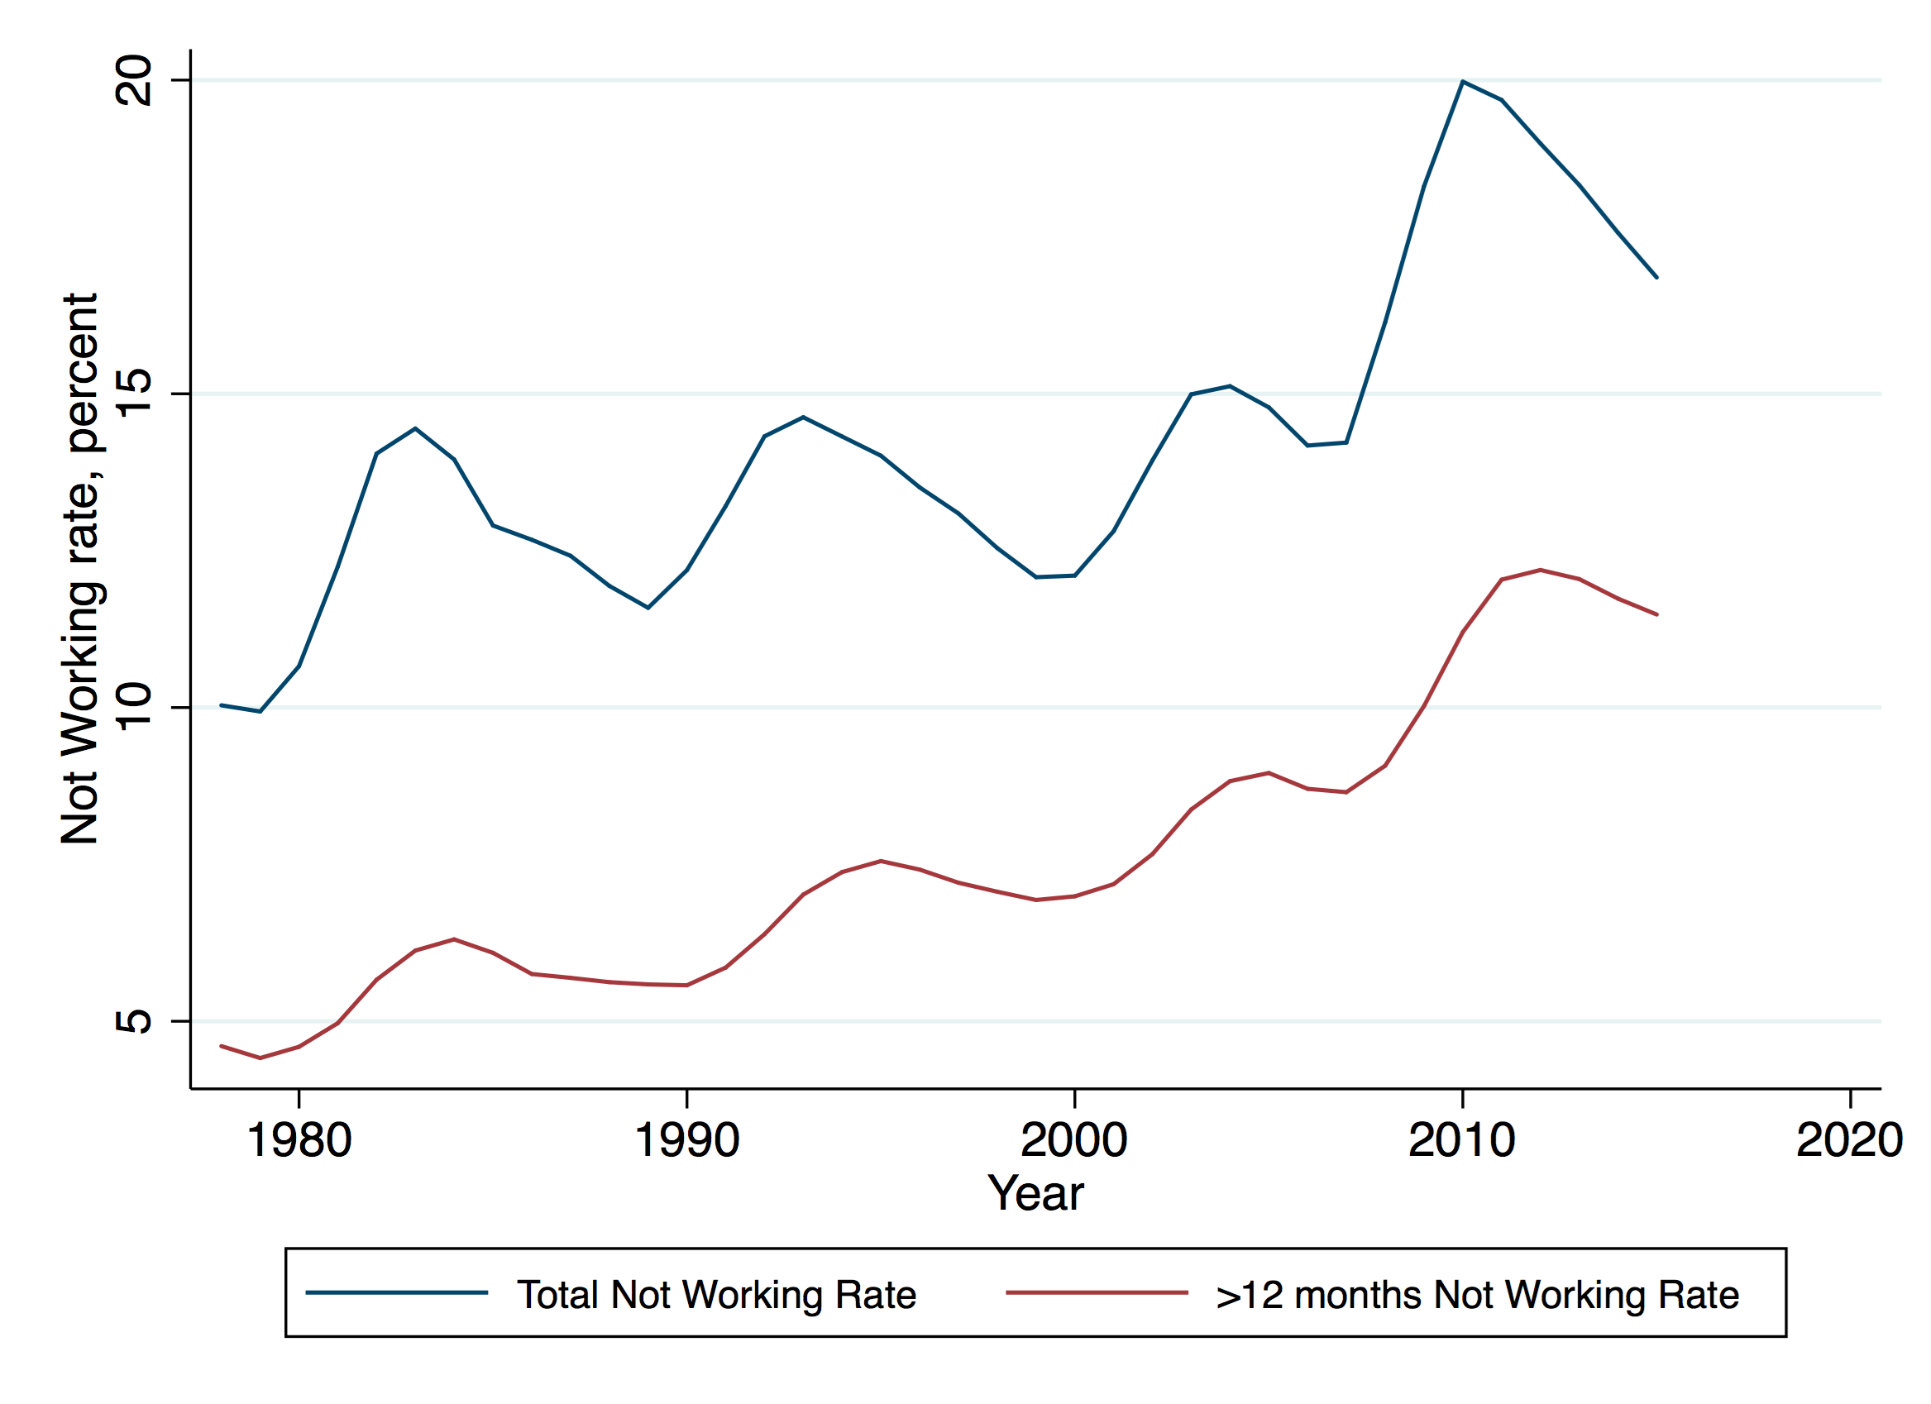
The Rise of Non-Employed Men

Slide 2
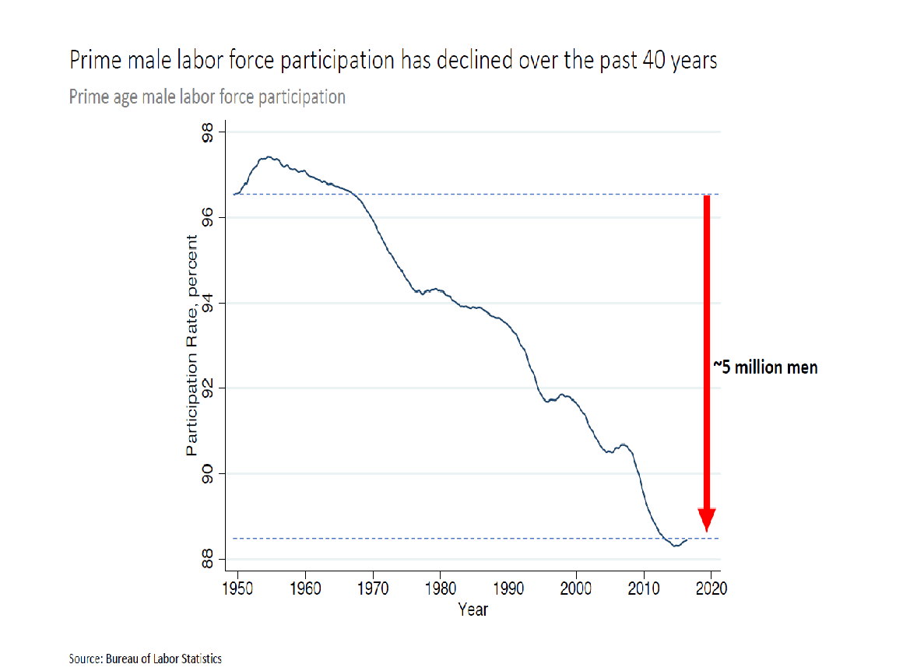

Slide 3
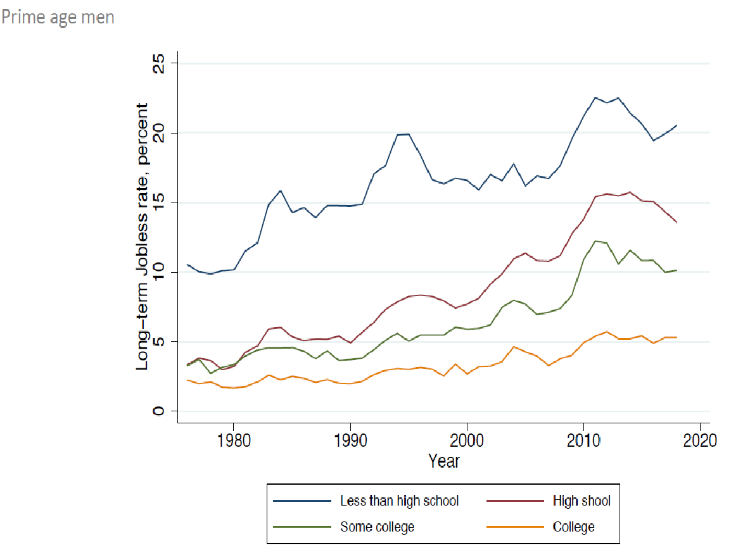

Slide 4
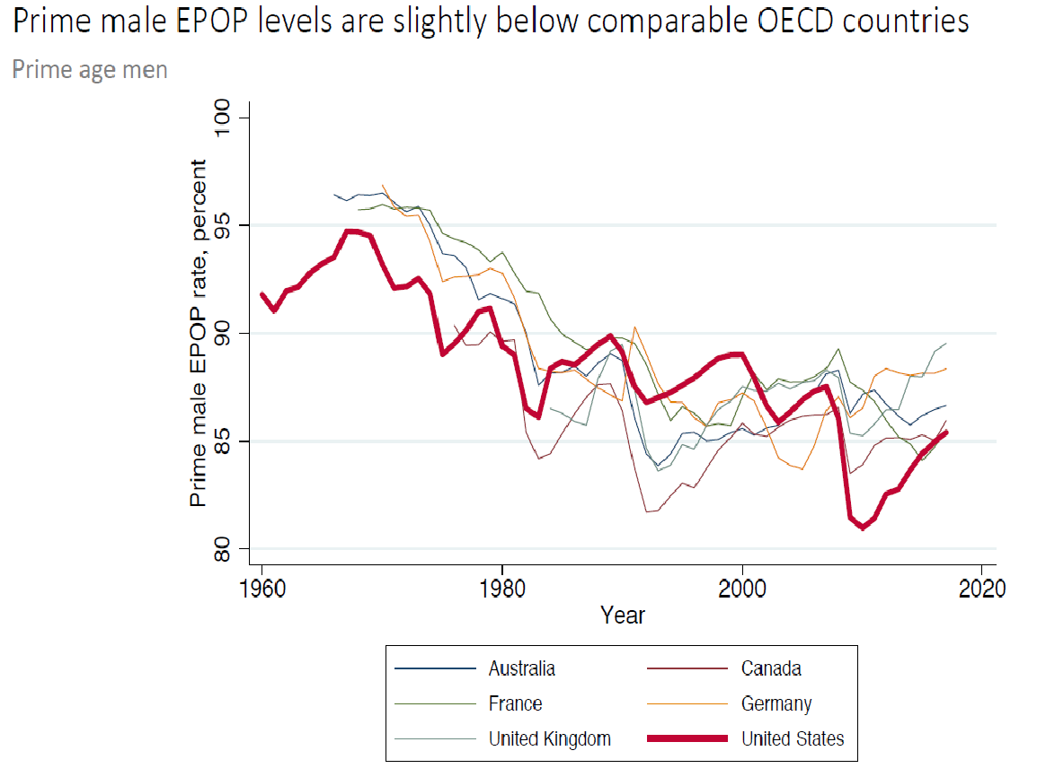

Slide 5
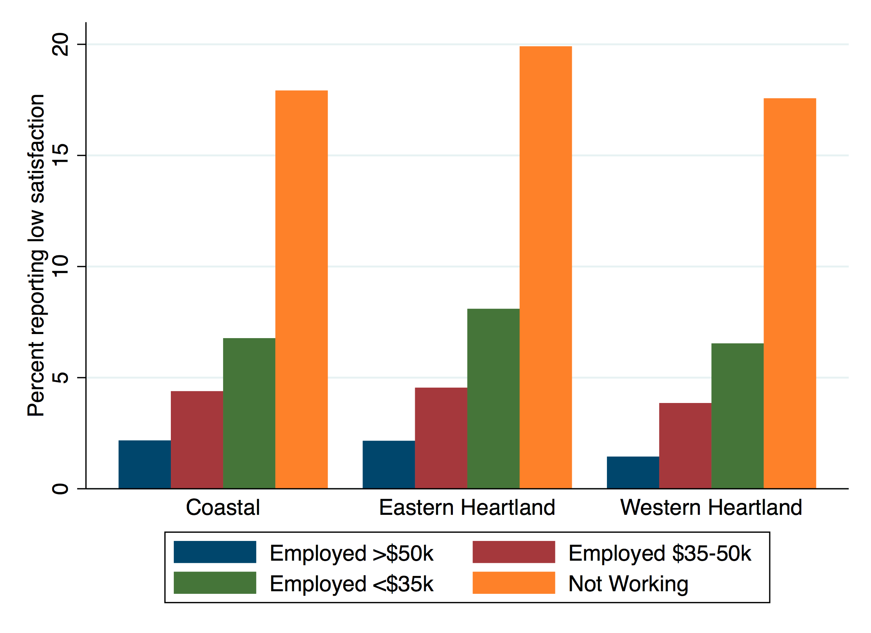
Low life satisfaction of men who are not working

Slide 6
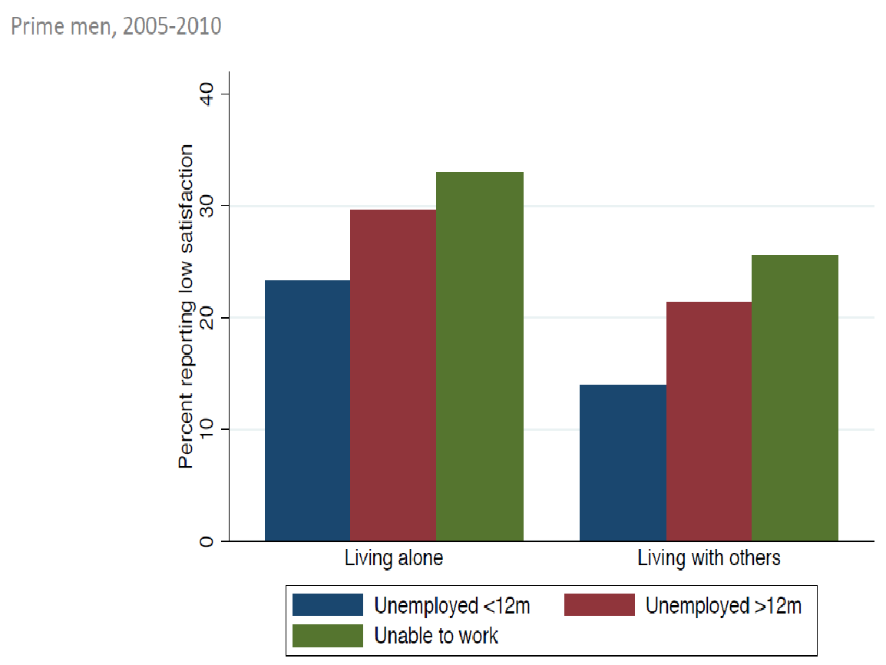

Slide 7
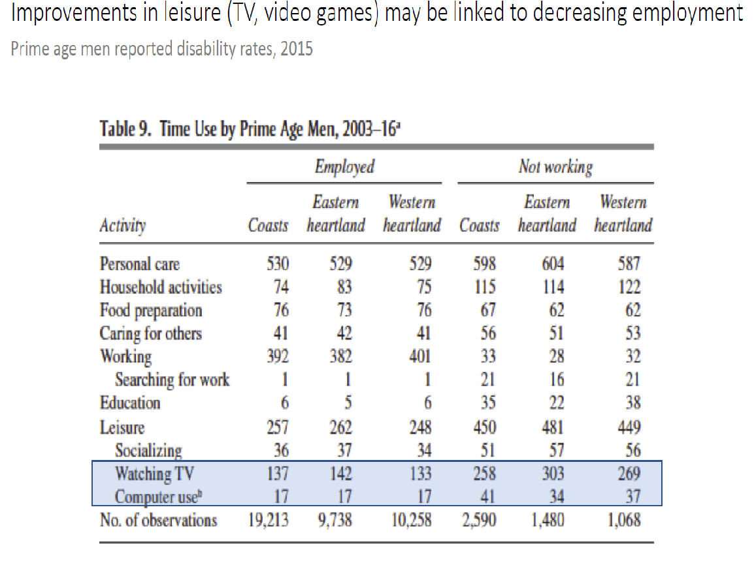

Slide 8
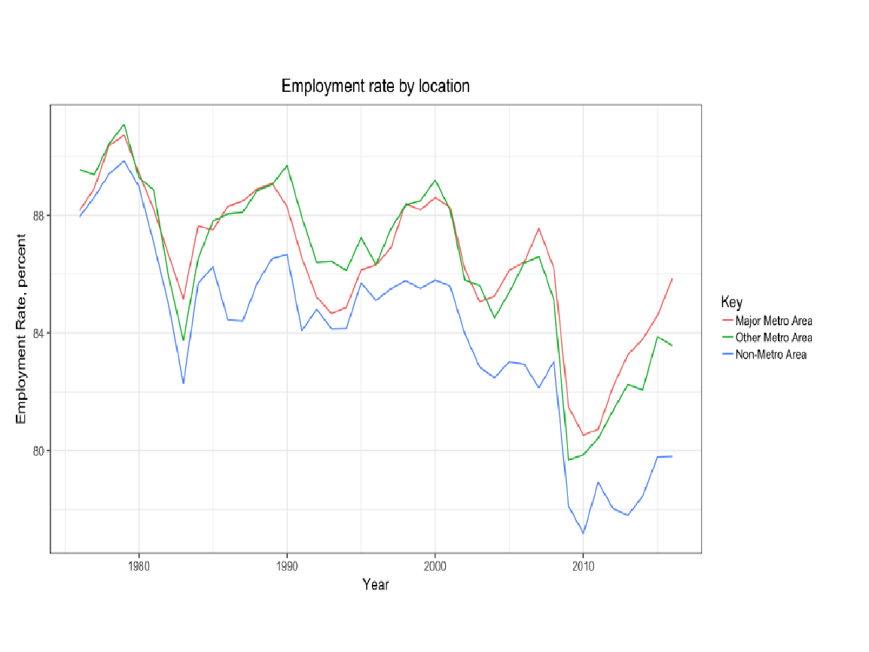

Slide 9
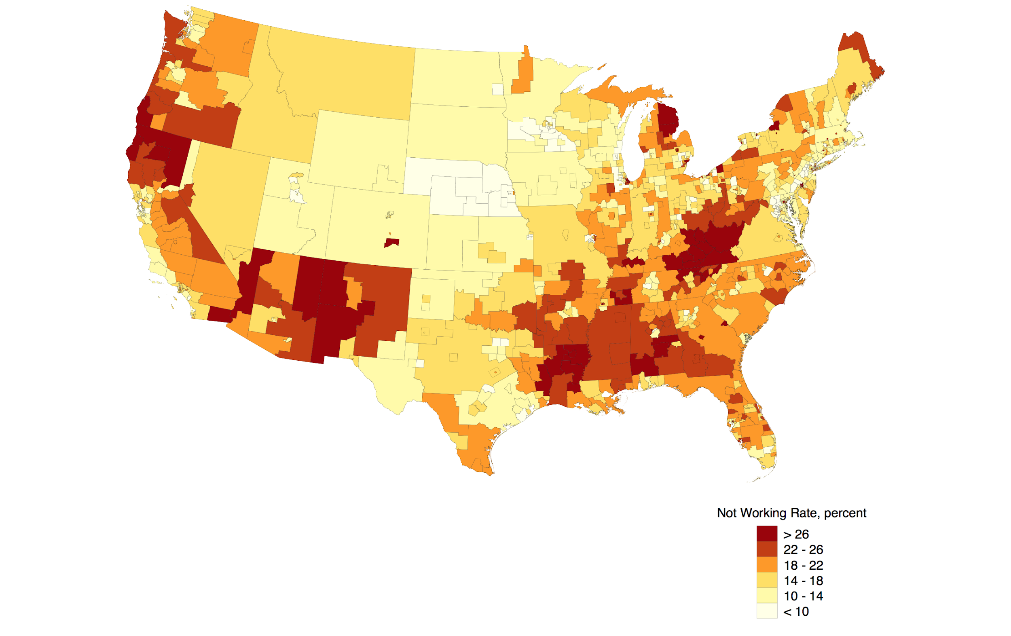
Geography of not working: Prime men 2015

Slide 10
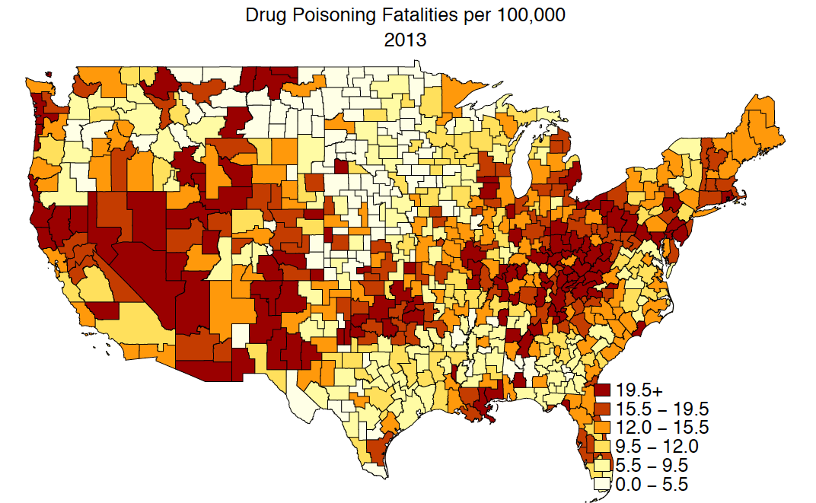

Slide 11
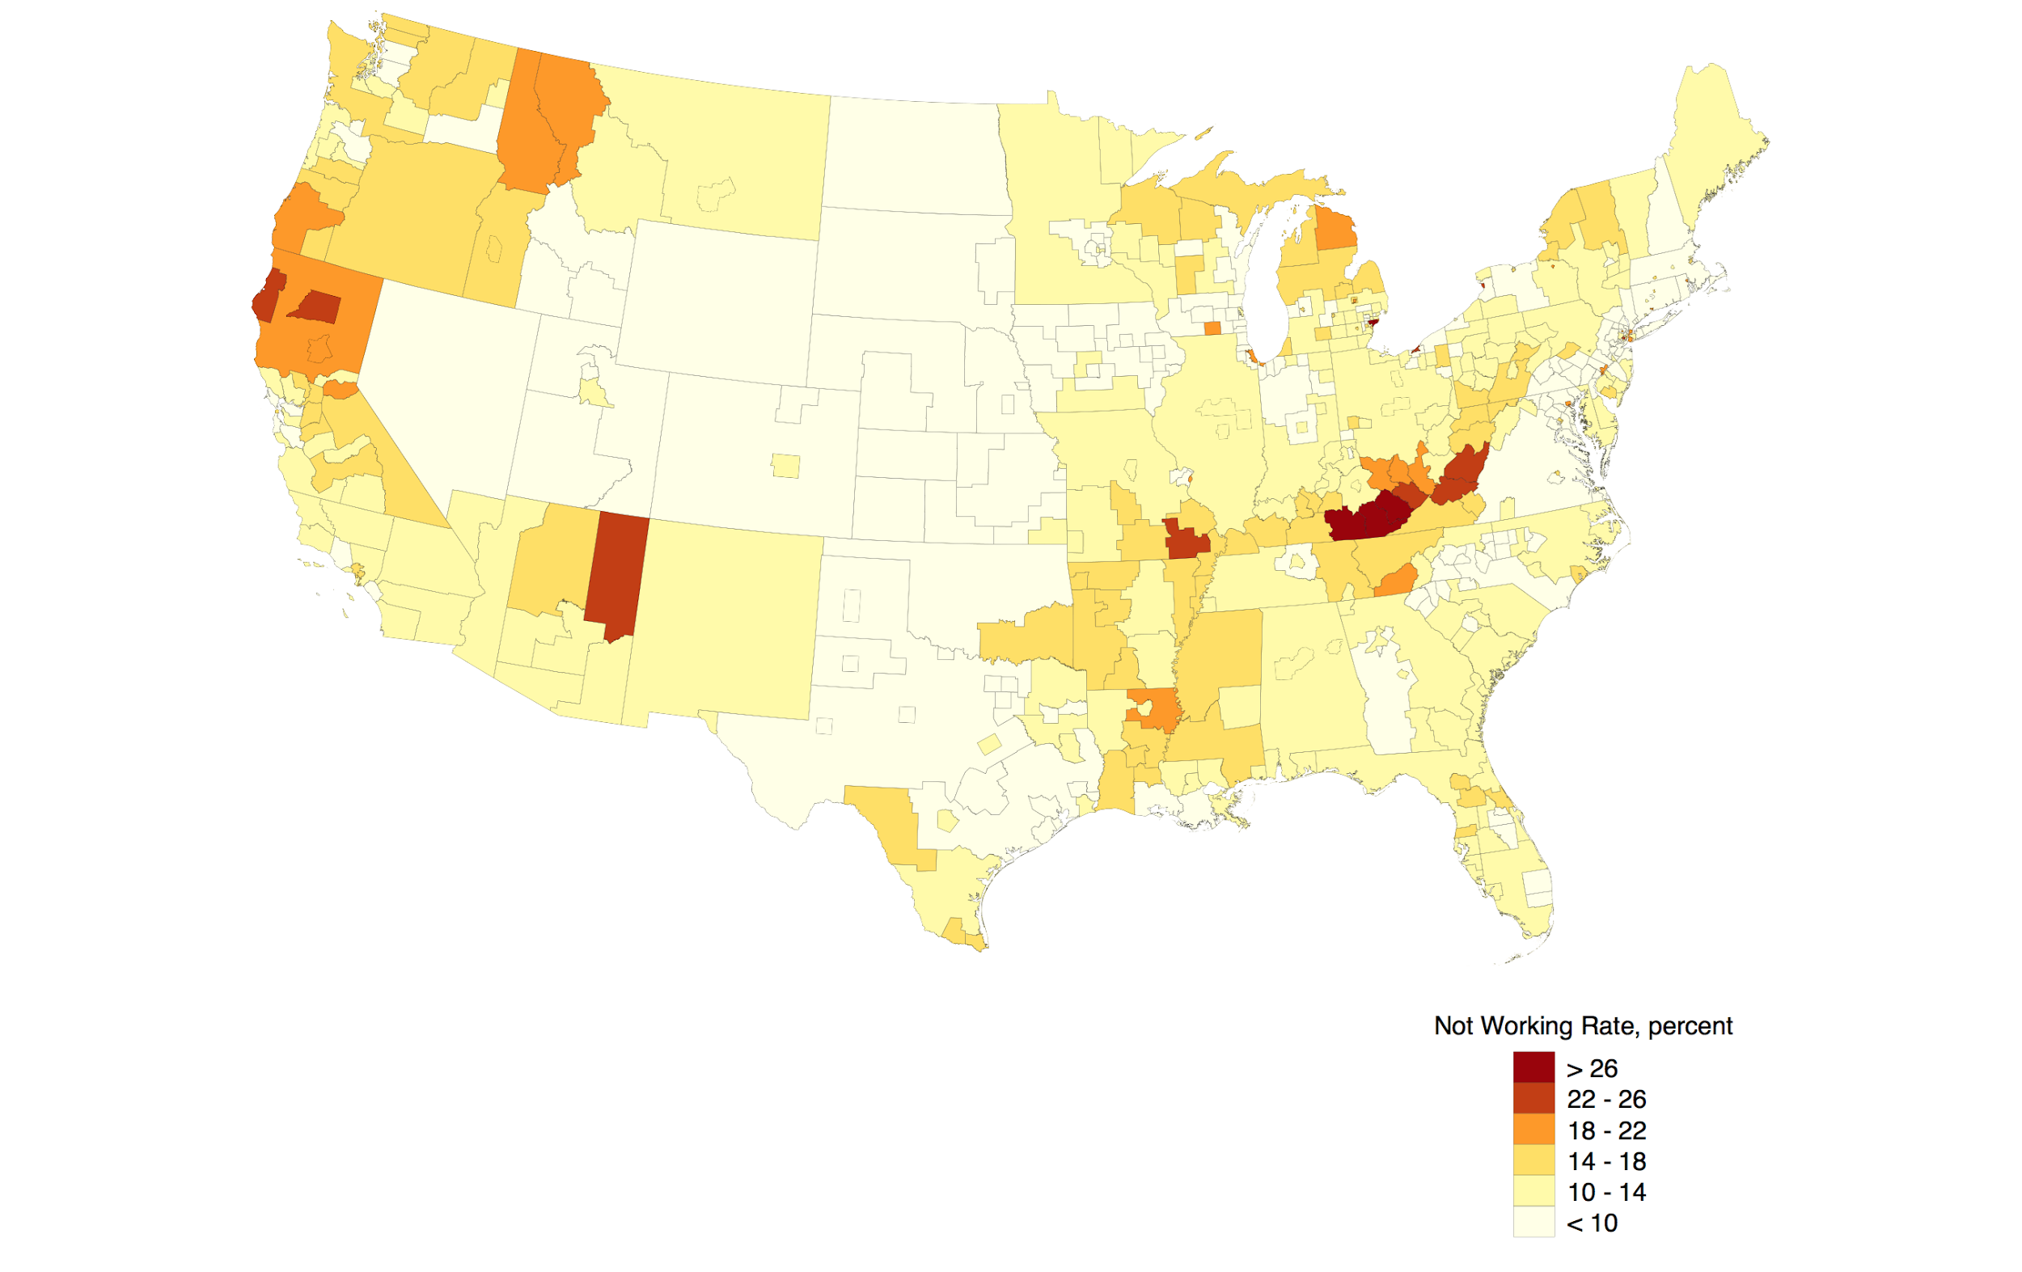
Geography of not working: Prime aged men 1980

Slide 12
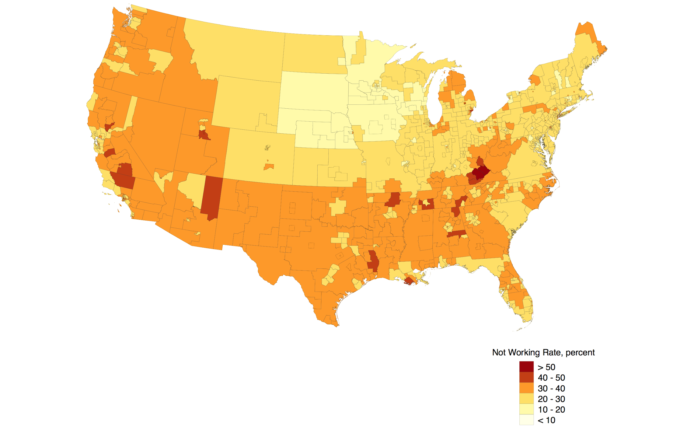
Geography of not working: Prime aged women 2015

Slide 13
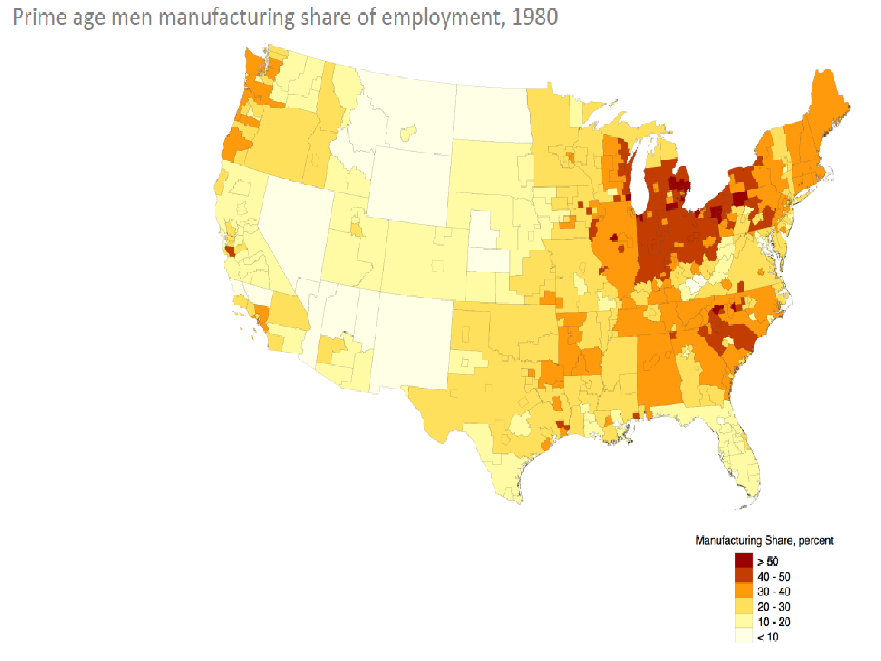

Slide 14
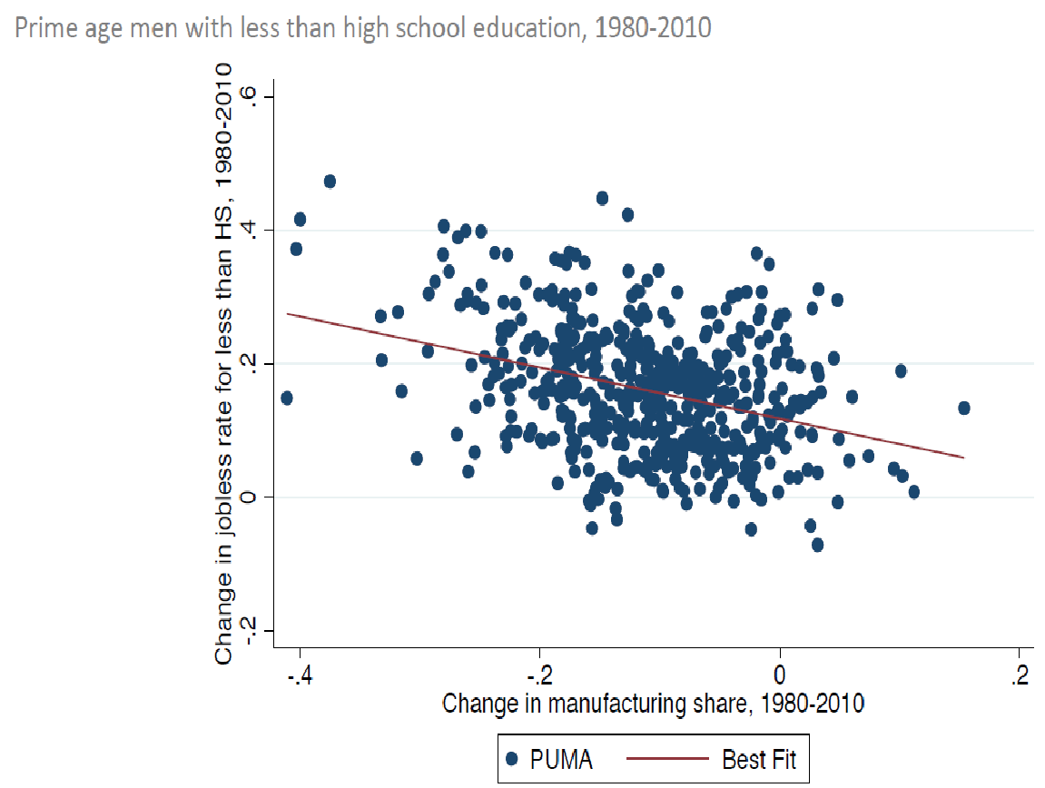

Slide 15
The O’Neill (Tip) Hypothesis: All Jobs Are Local (Non-Traded), Eventually
The argument is that any good that can be shipped essentially has a global market, which means that there are large scale economies, which lead to capital replacing labor.
12.8 million manufacturing jobs are left in the US
Services dominate employment
(1) business and professional (21.2 million),
(2) retail and whole trade (21.7 million),
(3) education and health (24 million),
(4) leisure and hospitality (16.5 million)

Slide 16
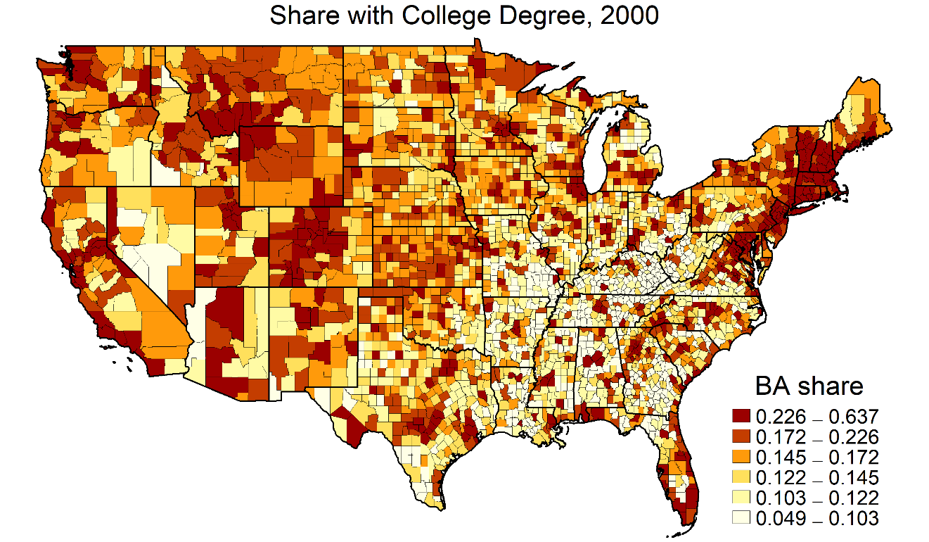
Growth, Rules and Schools

Slide 17
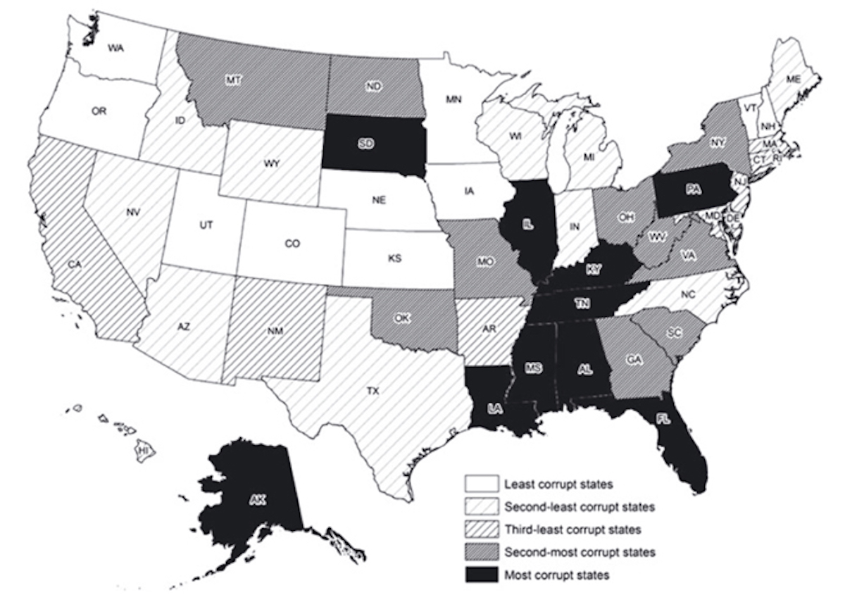
Figure is from Liu and
Mikesell(2014)
Public
Administration
Review

Slide 18
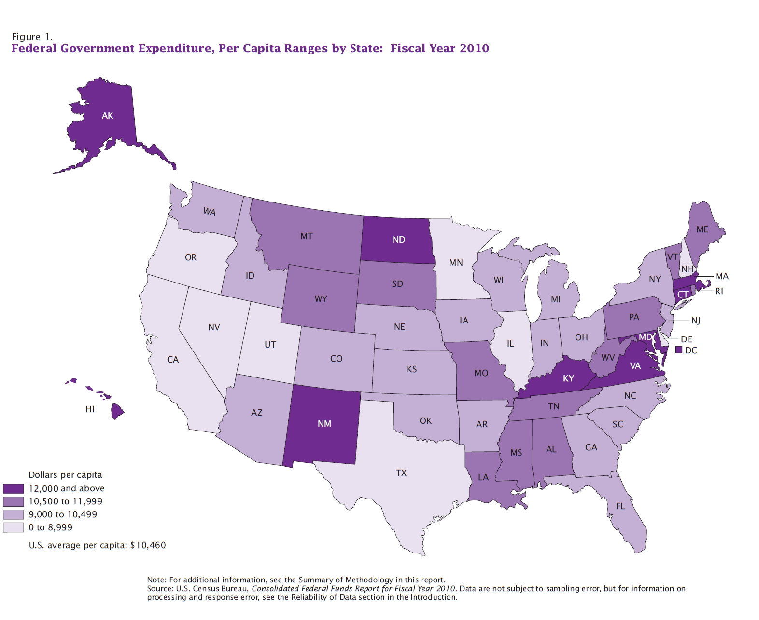

Slide 19
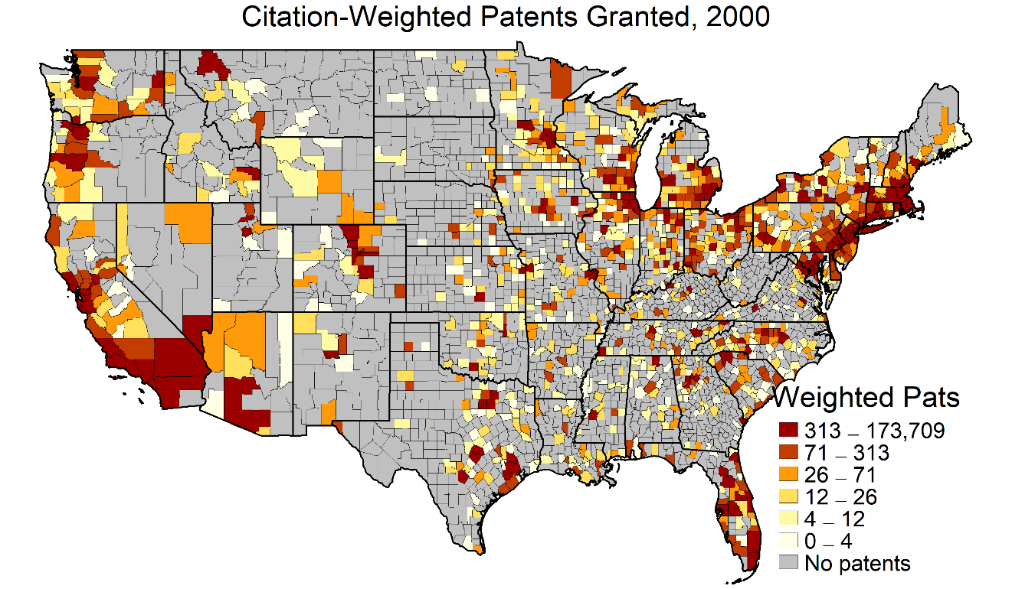

Slide 20
Geography of not working: Prime men 2015

Slide 21
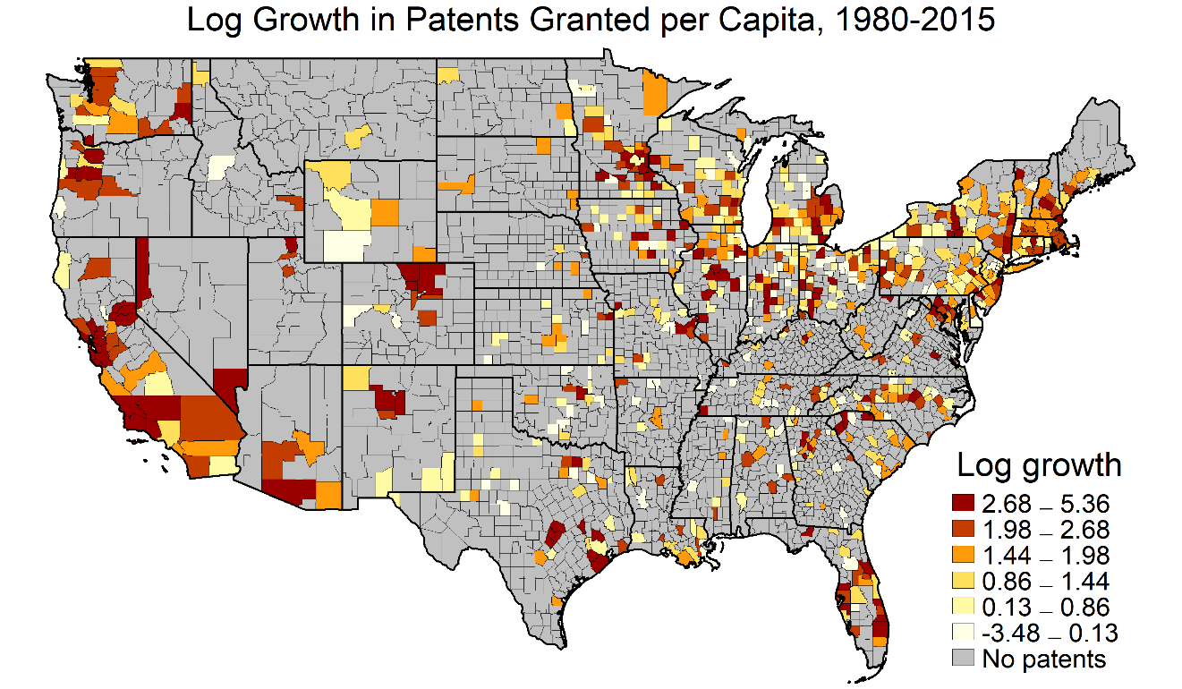

Slide 22
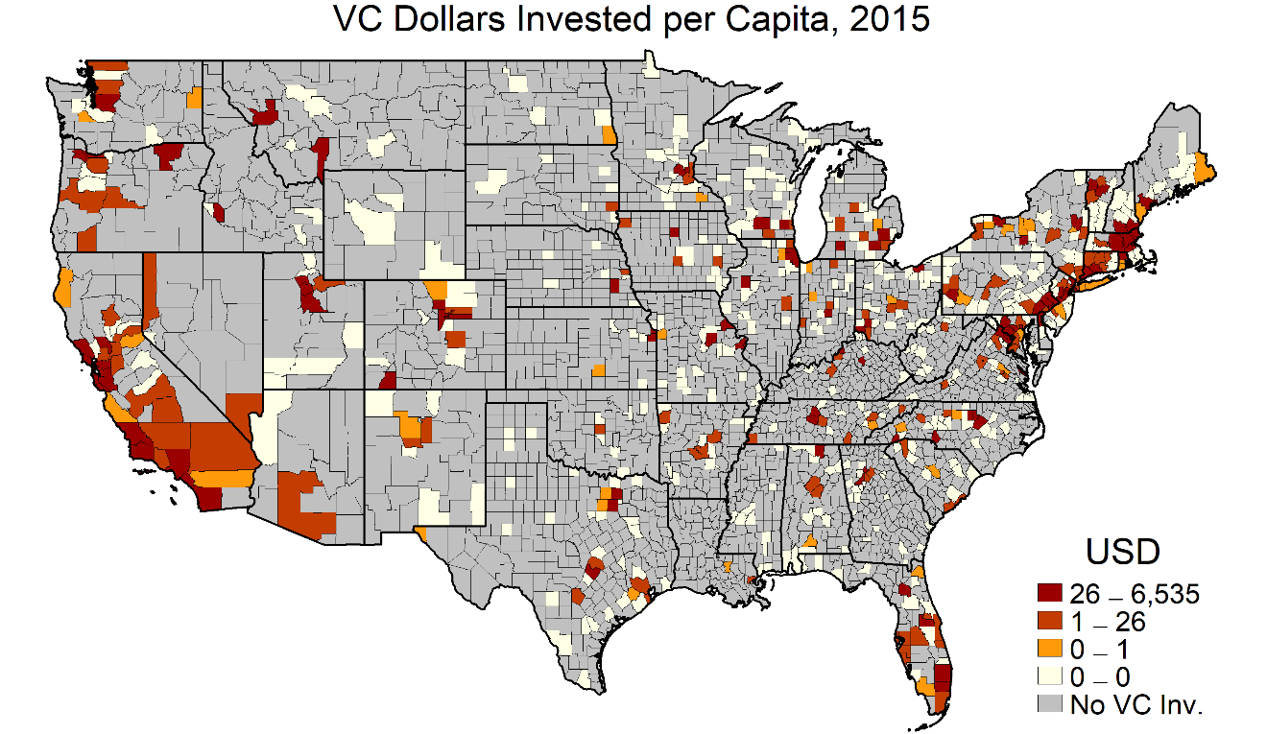

Slide 23
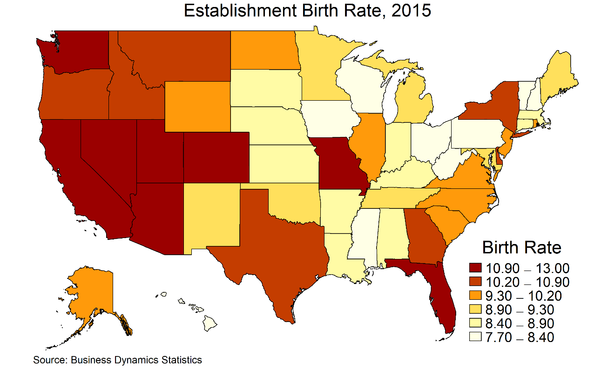

Slide 24
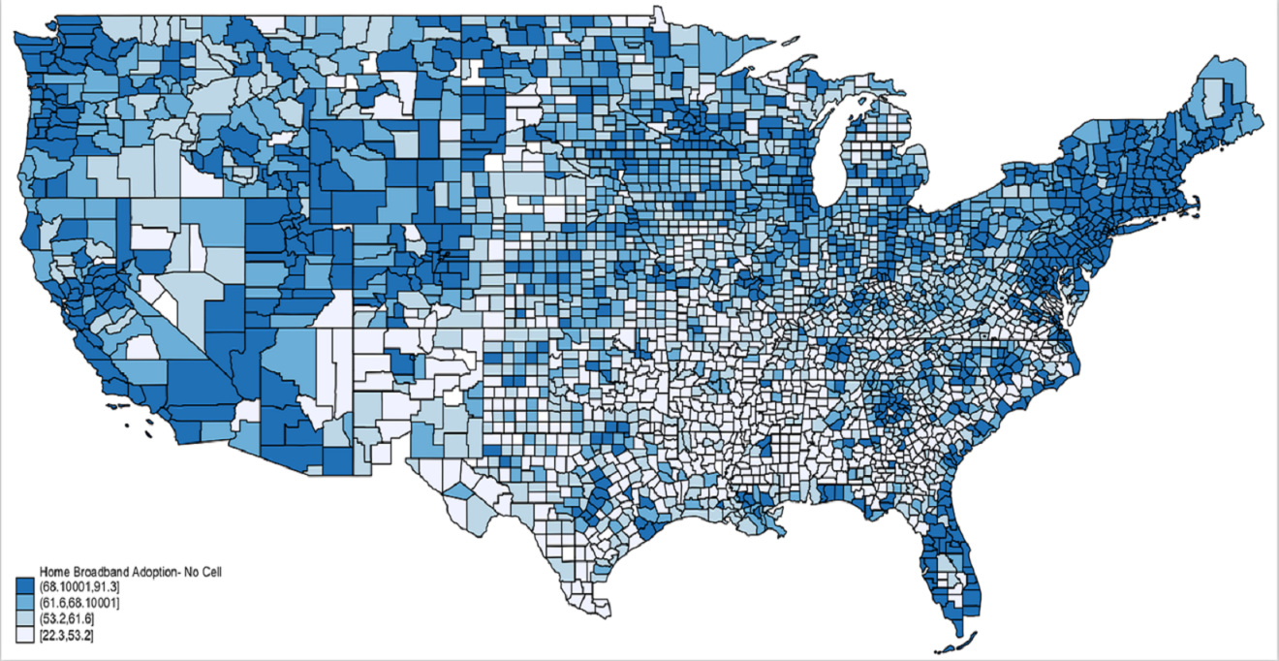
Home broadband: 2013-2017 averages

Slide 25
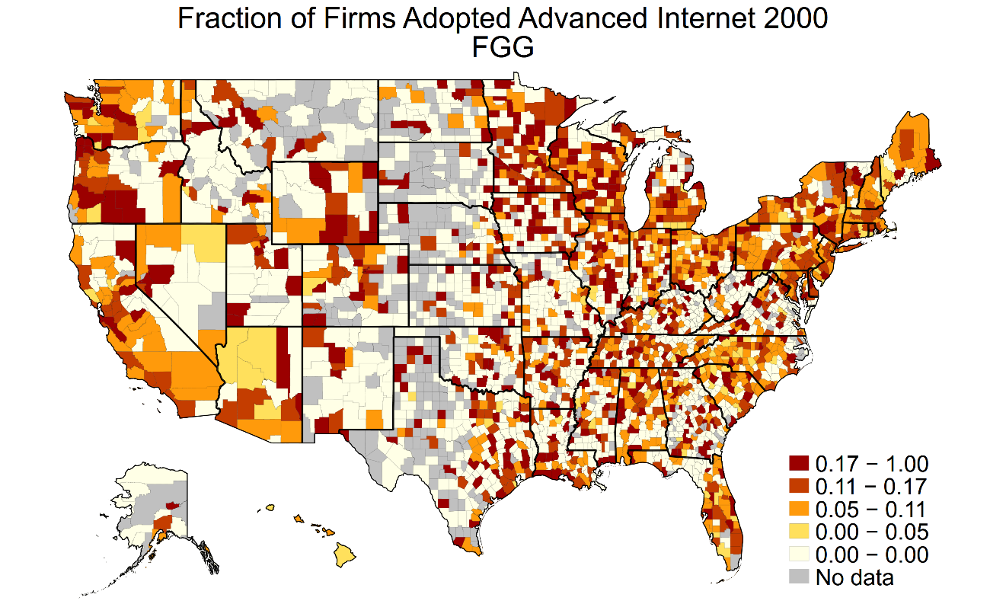

Slide 26
Addressing the Spatial Mismatch between Joblessness and Innovation
Approach # 1: Ignore the mismatch and don’t lose any sleep over it.
Approach # 2: Decide that innovation is the cure for everything and hurl everything at eastern Kentucky.
Approach # 3: Recognize the existence of spatially-heterogeneous externalities and incorporate them when appropriate.

Slide 27
Arguments against Place-Based (Innovation) Policies
Subsidizing declining places keeps people in dysfunctional local economies (e.g. let them leave New Orleans)
Perhaps less important with lower migration rate.
Subsidizing any places leads to capitalization in real estate prices (e.g. the poor renters in Bilbao who doesn’t like contemporary art).
As people are less mobile this may be less important.
The relative importance of capitalization vs. distorted migration depends on housing supply elasticity.
Some declining places (Detroit) have fixed housing supplies.
If place based policies deliver aid to low income individuals and the unemployed, then they can create pockets of poverty.
Innovation targets the most skilled people in society, and you we are trying to help the least skilled.
Infrastructure place-based policies can lead to waste.

Slide 28
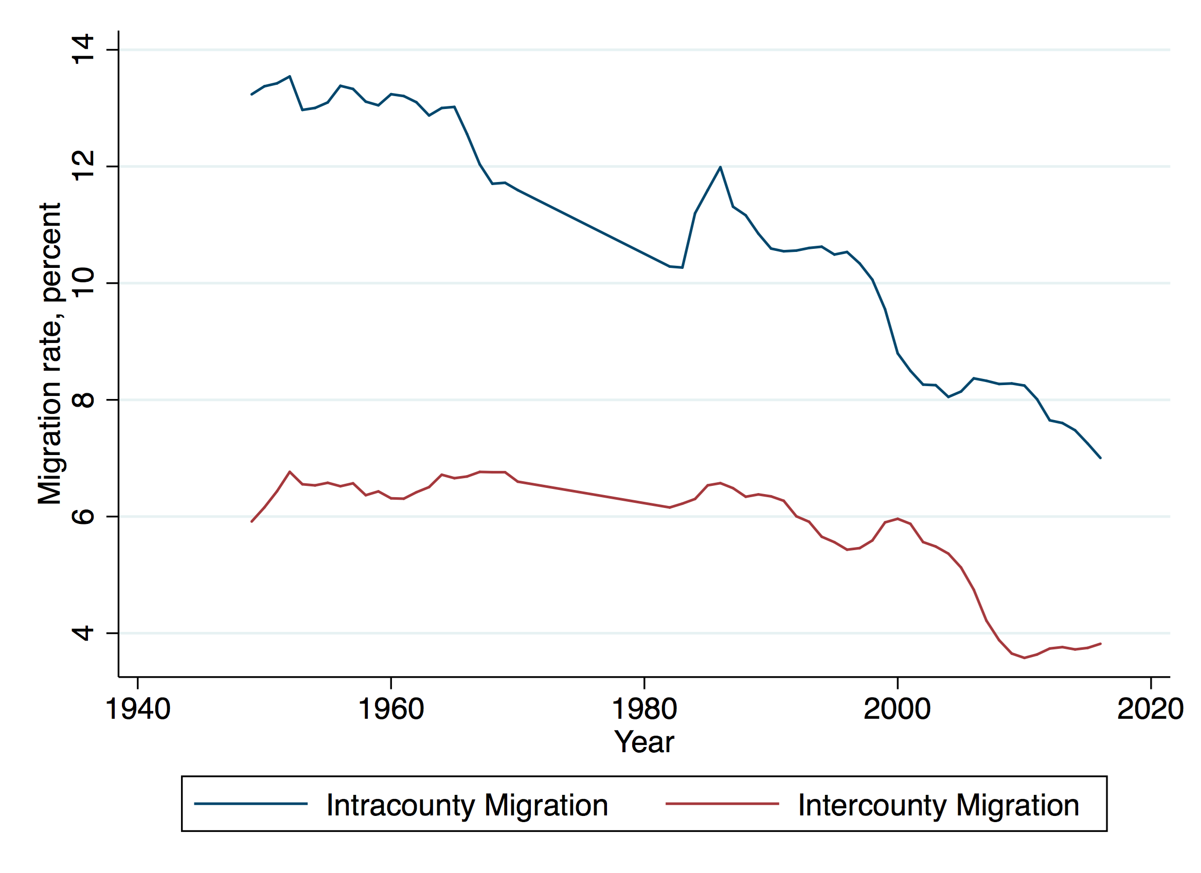
The decline in migration

Slide 29
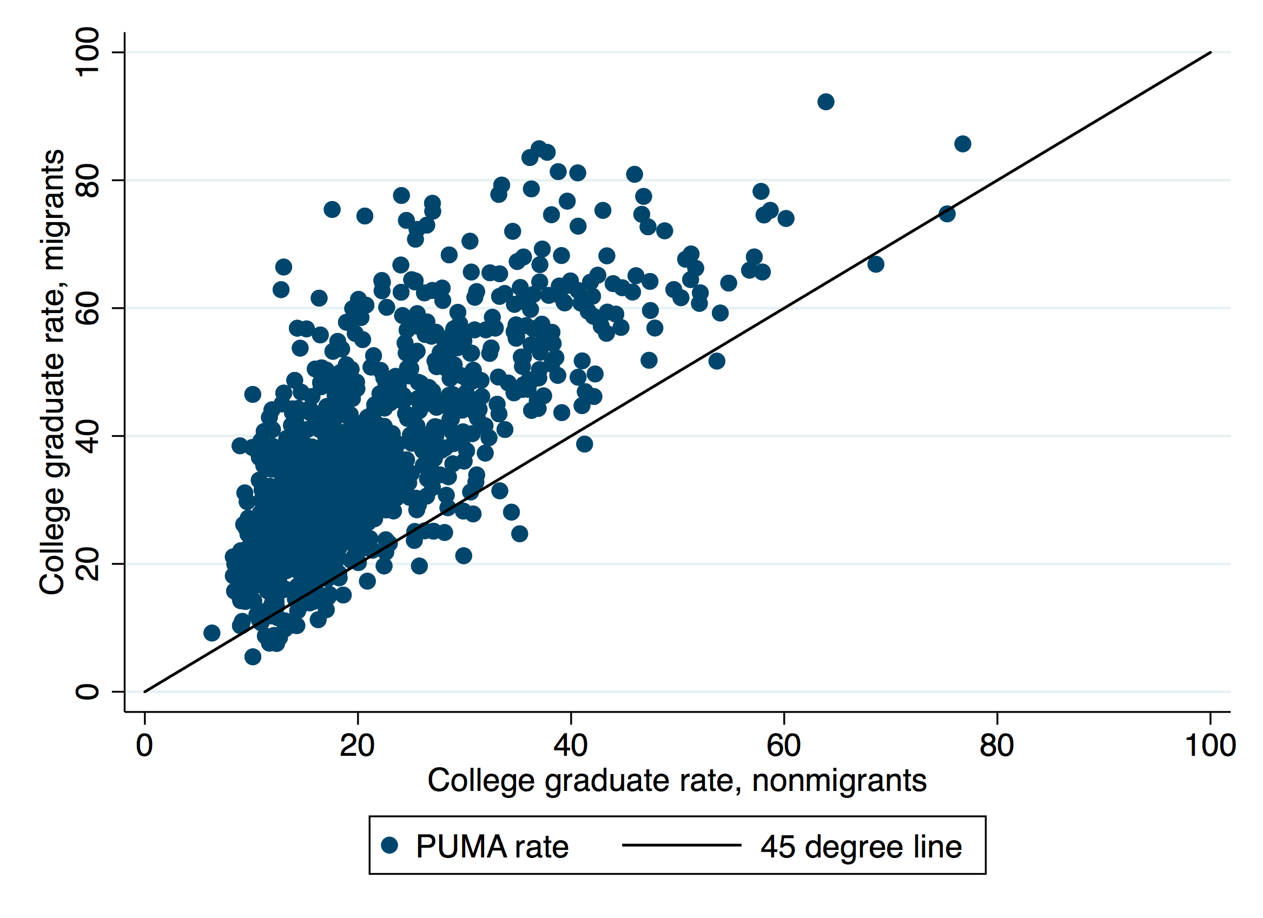
Skilled migration

Slide 30
American Geographic Sclerosis
Migration (especially migration of the less skilled) is not directed towards high wage areas (Ganong and Shoag, 2017)
Successful areas make it increasingly difficult to build low cost housing (Glaeser, Gyourko, Saks, 2005), leading to spatial mismatch of people and productivity (Hsieh and Moretti, 2016).
In the world of labor-intensive manufacturing, low wage areas attracted capital (Holmes, 1997); in our service economy, the skilled don’t move to West Virginia for cheap nannies and hair cuts.
Change in share with college degrees positively correlated with initial share of population with college degrees (Moretti, 2004).
Income convergence across metropolitan areas or PUMAs has slowed or disappeared entirely (Berry and Glaeser, 2006)
Log(Y₂₀₁₀/Y₁₉₈₀)=.01* Log(Y₁₉₈₀) (IV with 90th and 10th percentile in 1980).

Slide 31
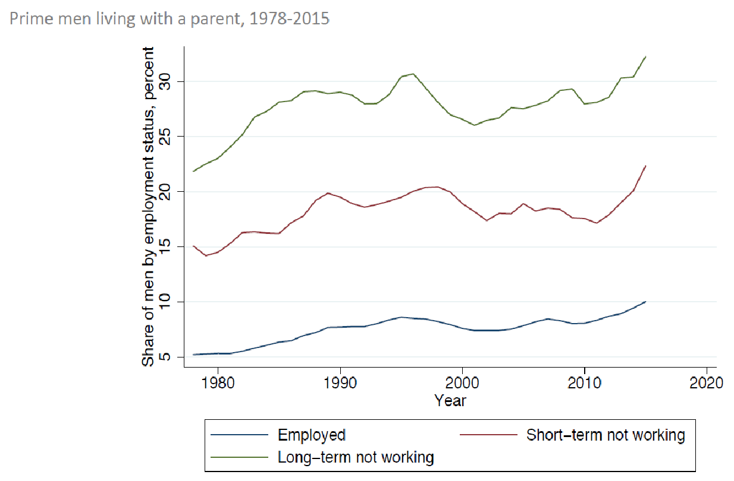

Slide 32
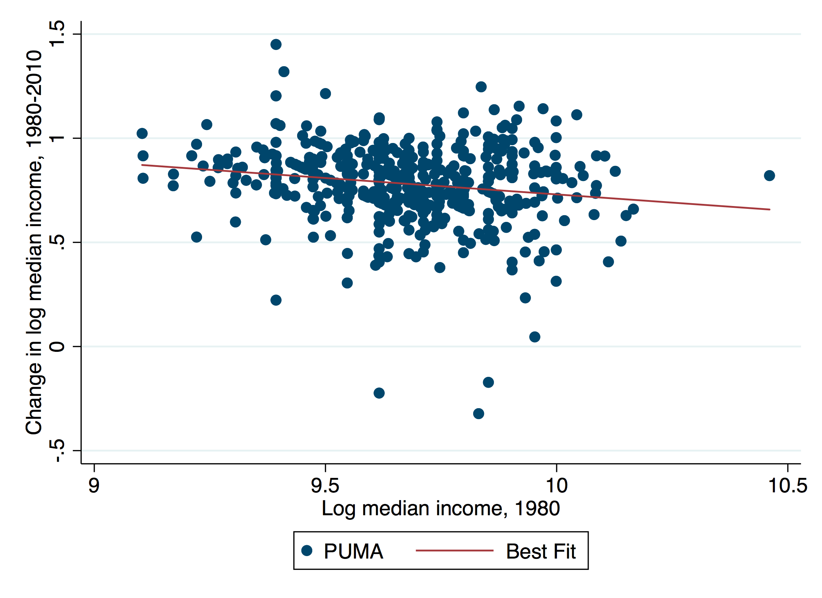
Income convergence has stalled

Slide 33
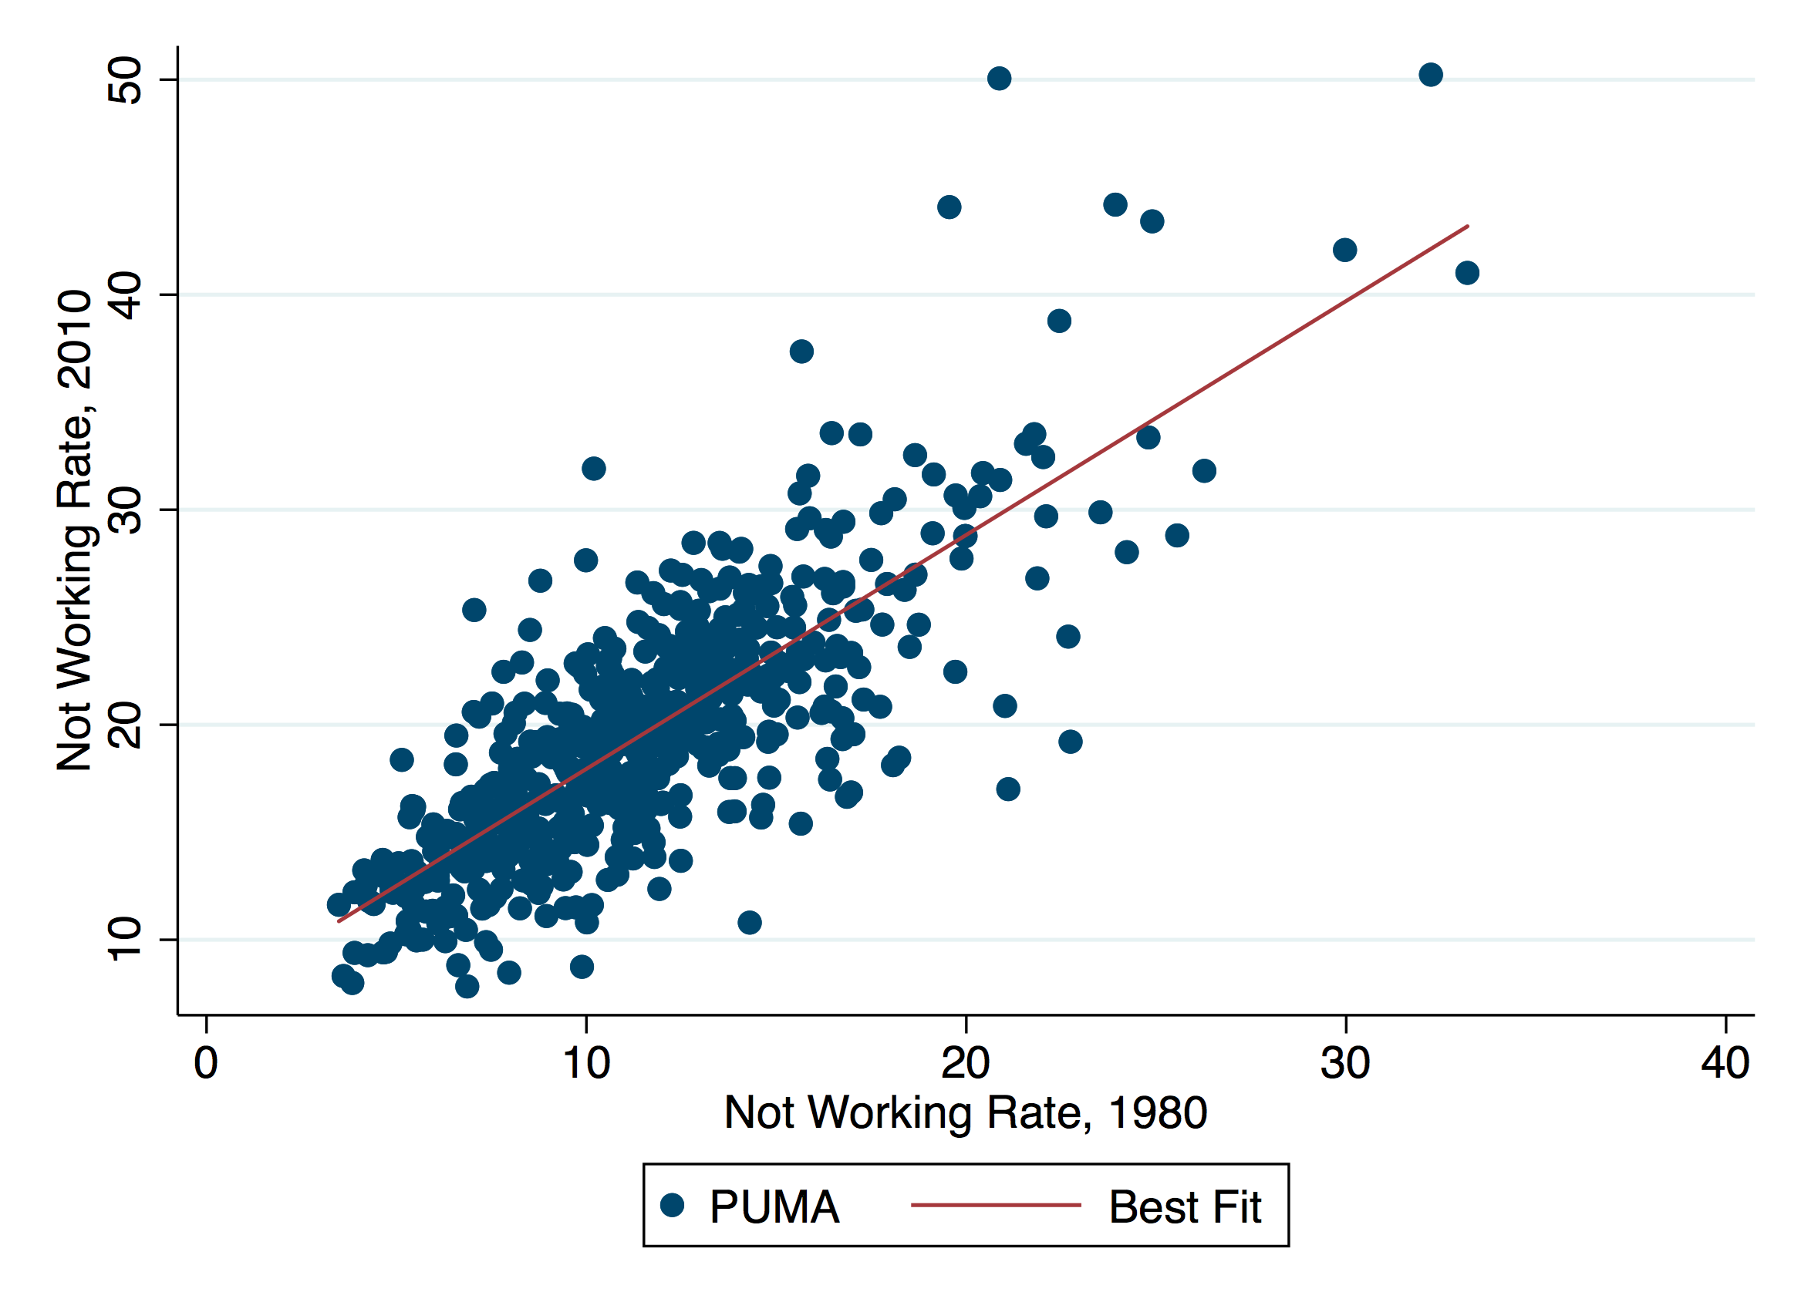
Hysteresis of Not Working (1.08 coefficient)

Slide 34
Well that last one is certainly still true

Slide 35
1. Place-Based Externalities in Research, H.C. or Economic Activity
Agglomeration economies are now generally accepted by urbanists (dlog(wage)/dlog(density)=.06 or so).
Congestion externalities are also quite real (pollution, traffic, etc.).
Human capital externalities may be more contentious, but also appear big.
We believe that these externalities surely exist within research and entrepreneurship communities as well.
Chinitz and cultures of entrepreneurship. Saxenian on Rte 128 and the Valley.
These externalities mean that a decentralized spatial equilibrium is unlikely to be a social optimum.
But we don’t know– and are unlikely ever to know– enough about their shape to know the direction that we should be directing.
Should we move scientists from Boston to Rochester or vice-versa?
The best identification strategies (soil attributes, land grant colleges, Million Dollar plants) seem unlikely to nail the full set of functional forms needed to implement.

Slide 36
2. Redistribution via Place
In 1969, Detroit was slightly richer than Boston, today Boston incomes are 40 percent higher.
Insuring individuals against shocks to the local economy would be welfare improving.
Pretty non-distortionary if based on place-of-birth, but place-of-birth is pretty inconceivable as a policy.
A related argument is that place may be a “tag” for low income and subsidizing place may be less distortionary than subsidizing low income.
The big limitation is that states explain only 1.2 percent of income variability. Consequently, the upside is limited.
Innovation policy is also pretty terribly targeted towards redistribution.

Slide 37
3. Different Elasticities Imply Different Policies for Research and Welfare
Example # 1: Federal Housing Construction Subsidies. LIHTC may be appropriate in MA and CA, but madness in places where housing is elastic like TX or where housing is priced below construction costs (Detroit).
Example # 2: Hot Spots Policing. Police departments throw more resources and places where there is more crime, presumably because the marginal effect of a police officer on the level of crime is higher there.
Example # 3: The impact of federal spending on research may be higher in Rochester than in Boston
Example # 4: Subsidizing Employment (EITC) vs. Non-employment (Disability Insurance, Implicit Taxes from SNAP, Section 8, etc.).
In high employment markets, policies that deter employment may not matter.
In high non-employment areas, policies that deter employment may have awful consequences.
Is the marginal impact of an employment subsidy higher in West Virginia than in Seattle?
Think of Non-employment as an negative externality – then you want to tax/subsidize just like pollution or congestion

Slide 38
Innovation Policy: Education, Invention, Entrepreneurship
Gruber and Johnson make a case for expanding Federal spending on research and development and for targeting a few creative hubs away from the coasts.
As a political necessity for expanding research funding they are surely correct.
This is place-based invention policy.
We argue that the case is stronger for place-based education and entrepreneurship policy, especially if the goal is to internalize the benefits from reducing regional joblessness.

Slide 39
Place-Based Invention Policy
Social Benefit of Spending = dKnowledge/dDollar*dWelfare/dKnowledge
Spend more where this is higher.
Argument # 1 is that you get more knowledge per dollar in distressed areas.
Spending panels are supposed to equalize dKnowledge/dDollar already
Argument # 2 is that you get more jobs per knowledge created in distressed areas.
Seems possible, but the price per jobs will be high
Encouraging entrepreneurs in distressed areas

Slide 40
Place-Based Invention in Practice
1950, the N.S.F. Founding Act proclaimed: “it shall be an objective of the Foundation to strengthen research and education in the sciences and engineering, including independent research by individuals, throughout the United States, and to avoid undue concentration of such research and education.”
This doesn’t seem to have worked out exactly.
The 1979 Established Program to Stimulate Competitive Research (EPSCoR) program first to 6 states, but mission creep is now up to 25 states.

Slide 41
National Academy of Sciences: ESPCOR Review
“the breadth and increasing complexity of the EPSCoR objectives have made it difficult to develop a rigorous assessment system with quantitative metrics.”
“several million dollars of funding and 5 years of effort were clearly not going to transform a state’s research capacity,”
This doesn’t mean it was bad.
“EPSCoR has been in operation for more than 30 years and, over this period, the program has invested several billion dollars in capacity-building activities, yet the same 10 states that received the highest level of research funding in 1977 still top the list,”
Again, not an indication that the spending was bad, but …

Slide 42
An Alternative: Invention For, but not in, Distressed America
Health-related innovations already both improve health and generate jobs in distressed America (for good and ill).
More targeted N.I.H. focus on getting people off of disability in the heartland.
More research on long distance delivery of healthcare for remote regions (David Cutler).
Knowledge is highly mobile, so there is little need for it to locate where it is needed.

Slide 43
Bringing Human Capital to Distressed America
Foundation: Human capital yields spillovers, especially for the less skilled.
Aid and incentives for tech transfer for universities in distressed areas.
Entrepreneurial vocational training for the younger
Raise the cap on H1-B Visas for firms in distressed areas.
End enforcement of non-compete clauses in distressed America.

Slide 44
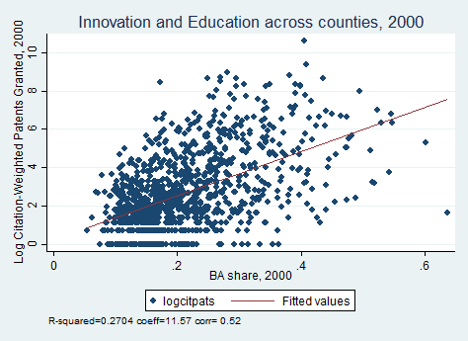

Slide 45
Subsidizing Tech Transfer in Distressed America
If the social benefit from job creation in distressed America (because of joblessness), then there is a case for encouraging more university-led entrepreneurship there.
It is also possible that universities don’t optimize around commercialization as well as firms.
Should we increase Federal overhead for tech transfer?
Should we make overhead (or Future grants) contingent on commercializing future research?

Slide 46
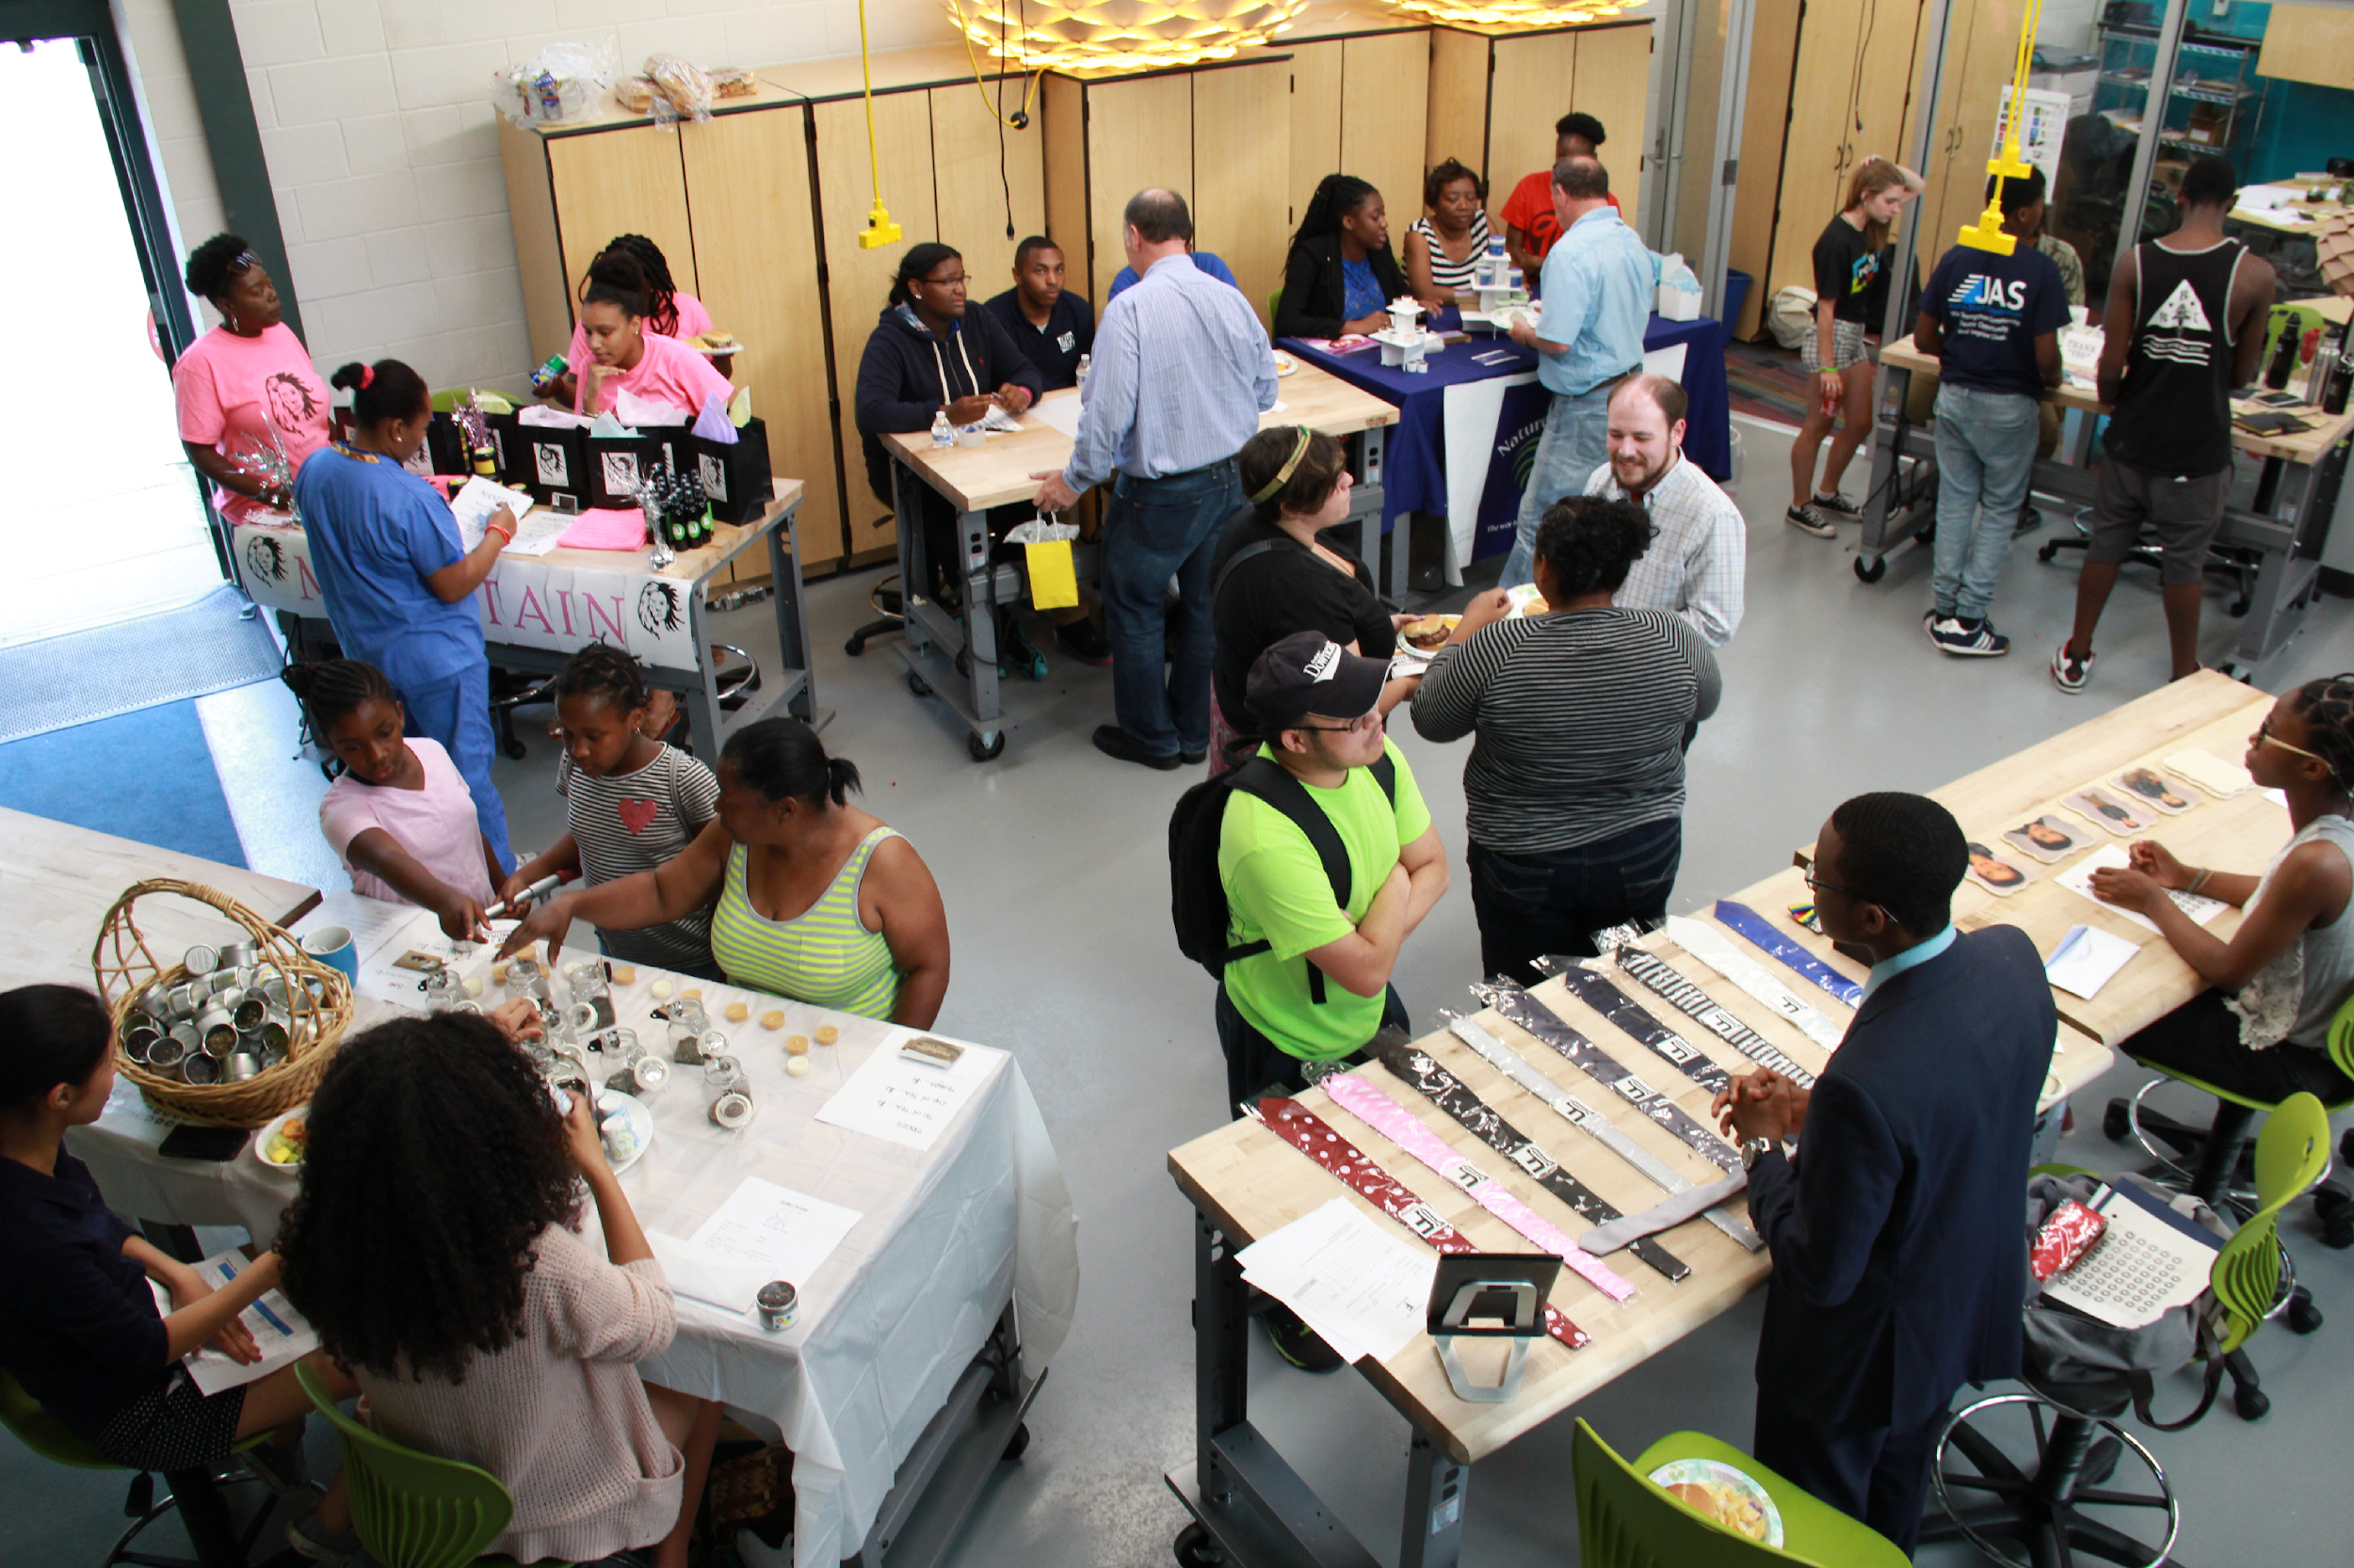
Promoting Inclusive Innovation: The Possible Project in Cambridge

Slide 47
The Locational Visa Debate
During the housing bust, there was some enthusiasm for allowing in more migrants to places with abundant housing.
Skilled immigrants can aid local fiscal distress and yield spillovers
Ozimek, Fikri and Lettieri push “Heartland Visas” where places sponsor immigrants.
But local governments won’t enforce location.
And they have less incentive to adopt.
An easier alternative is to lift the cap on H1-B visas for employers in distressed areas.
A ready constituency and easier to enforce.
The EB-5 investor program can also be expanded, but effects would be smaller.

Slide 48
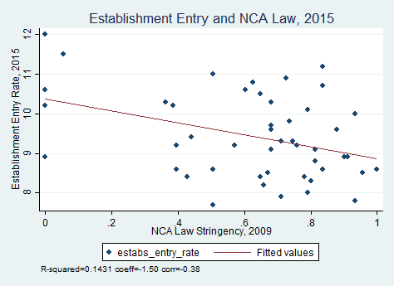

Slide 49
More Entrepreneurship for Distressed America?
Reduce barriers to new business formation and building near universities.
Entrepreneurship zones with one-stop permitting in distressed places.
Employment subsidies, and social policy reform, in distressed places.
Don’t support Universal Basic Income – probably ever, but certainly not if it augments existing policies (I know that violates NBER rules).

Slide 50
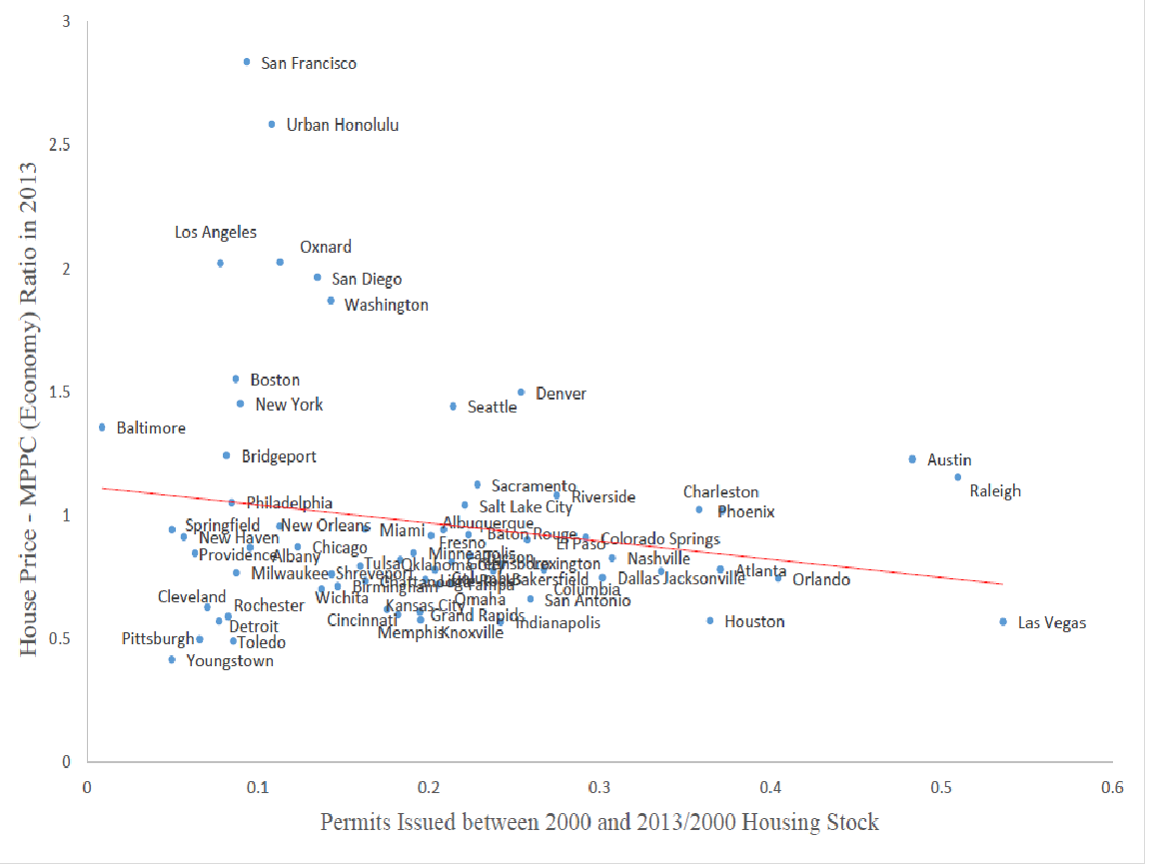

Slide 51
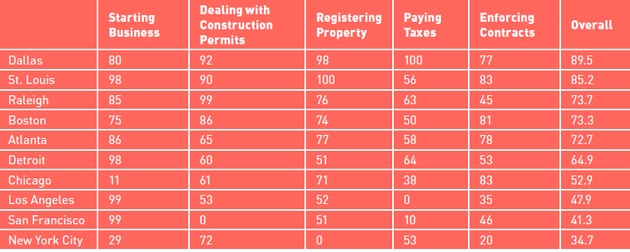
Chamber of Commerce Red Tape Index (Higher is Better, NYC is worst)

Slide 52
Saga of the Pink FlamInGo!

Slide 53
Roxbury Innovation Center

Slide 54
Spatial Bonus vs. Spatial Tilt
The Nice Variant
We have a set of policies that create positive externalities and internalities from working.
There may also be social spillovers from working (Topa, intra-household transfers).
Subsidizing working makes sense.
We should use our employment dollars where they will have the largest impact– in West Viriginia, not in Seattle.
Maybe, we should be open to simpler subsidies paid to firms.
And didn’t this work with empowerment zones (Busso et al.)
The Mean Variant
Don’t want to incentivize people to move to West Virginia.
So let’s tilt benefits from not-working to marginal workers in distressed areas– not subsidize distressed areas.
Ramp up employment subsidies in West Virginia and cut something else (Highways? Medicaid?) back to keep the total bundle constant.
This can be done in a way that is revenue neutral and doesn’t distort employment.
But don’t put the locals in charge (local discretion leads to a race to the bottom).

Slide 55
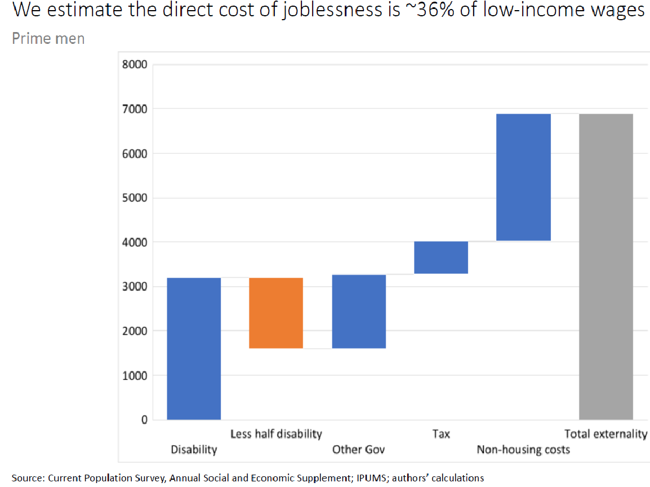

Slide 56
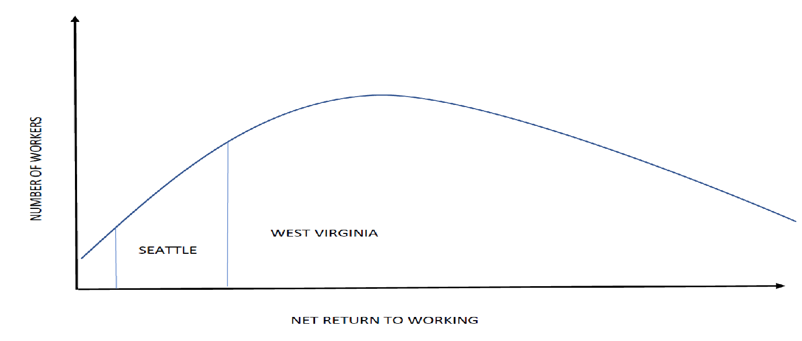
My View of the World: Different Employment means different numbers on the margin

Slide 57
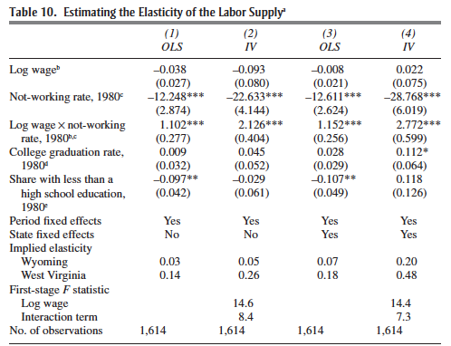

Slide 58
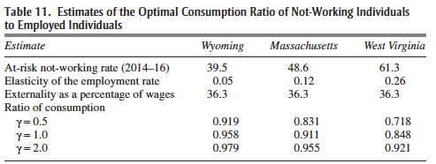

Slide 59
Contra Universal Basic Income
Given the multiple taxes on working current in social welfare programs, a UBI replacement could well increase effort
But as an add-on UBI would generate significant income effects which would deter working.
The negative income tax experiments of the 1970s reduced hours considerably, and men were more attached to the labor force then.
The longer-term political effects seem almost more dangerous.

Slide 60
But what are less skilled people going to do in the Eastern Heartland?
The answer, if it exists, is almost surely going to be in services.
But you need an export sector and manufacturing looks closed.
Leisure and hospitality?
We’re trusting to subsidies to solve a problem that looks insoluble to many.
This is not uncommon in economics.
This problem also exists in the poorer parts of the developing world.

